Slide 1
CHAPTER 18
Amino Acid Oxidation and the Production of Urea
Xiao-Wei Chen, Ph.D.
xiaowei_chen@pku.edu.cn

Slide 2
Outline of today’s lecture
Breakdown of proteins
Removal of the amino group
The urea cycle and related diseases
Breakdown of carbon-skeleton

Slide 3
Three scenarios of amino acid catabolism (oxidative degradation)
Normal synthesis and breakdown of proteins (protein turnover)
Dietary uptake of proteins exceeds needs for protein synthesis
Starvation or when carbohydrates are limited

Slide 4
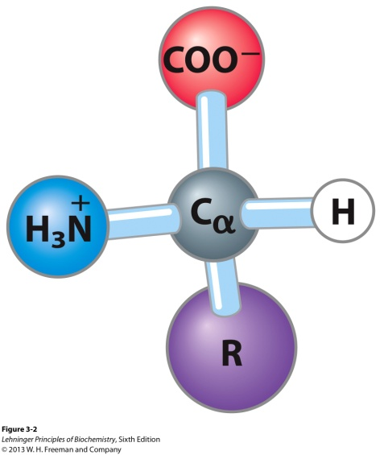
Overview of amino acid catabolism
Carboxyl group
Removal of the amino groups by transamination
The leftover carbon skeletons are converted to common intermediates of energy-producing pathways.
Amino group

Slide 5
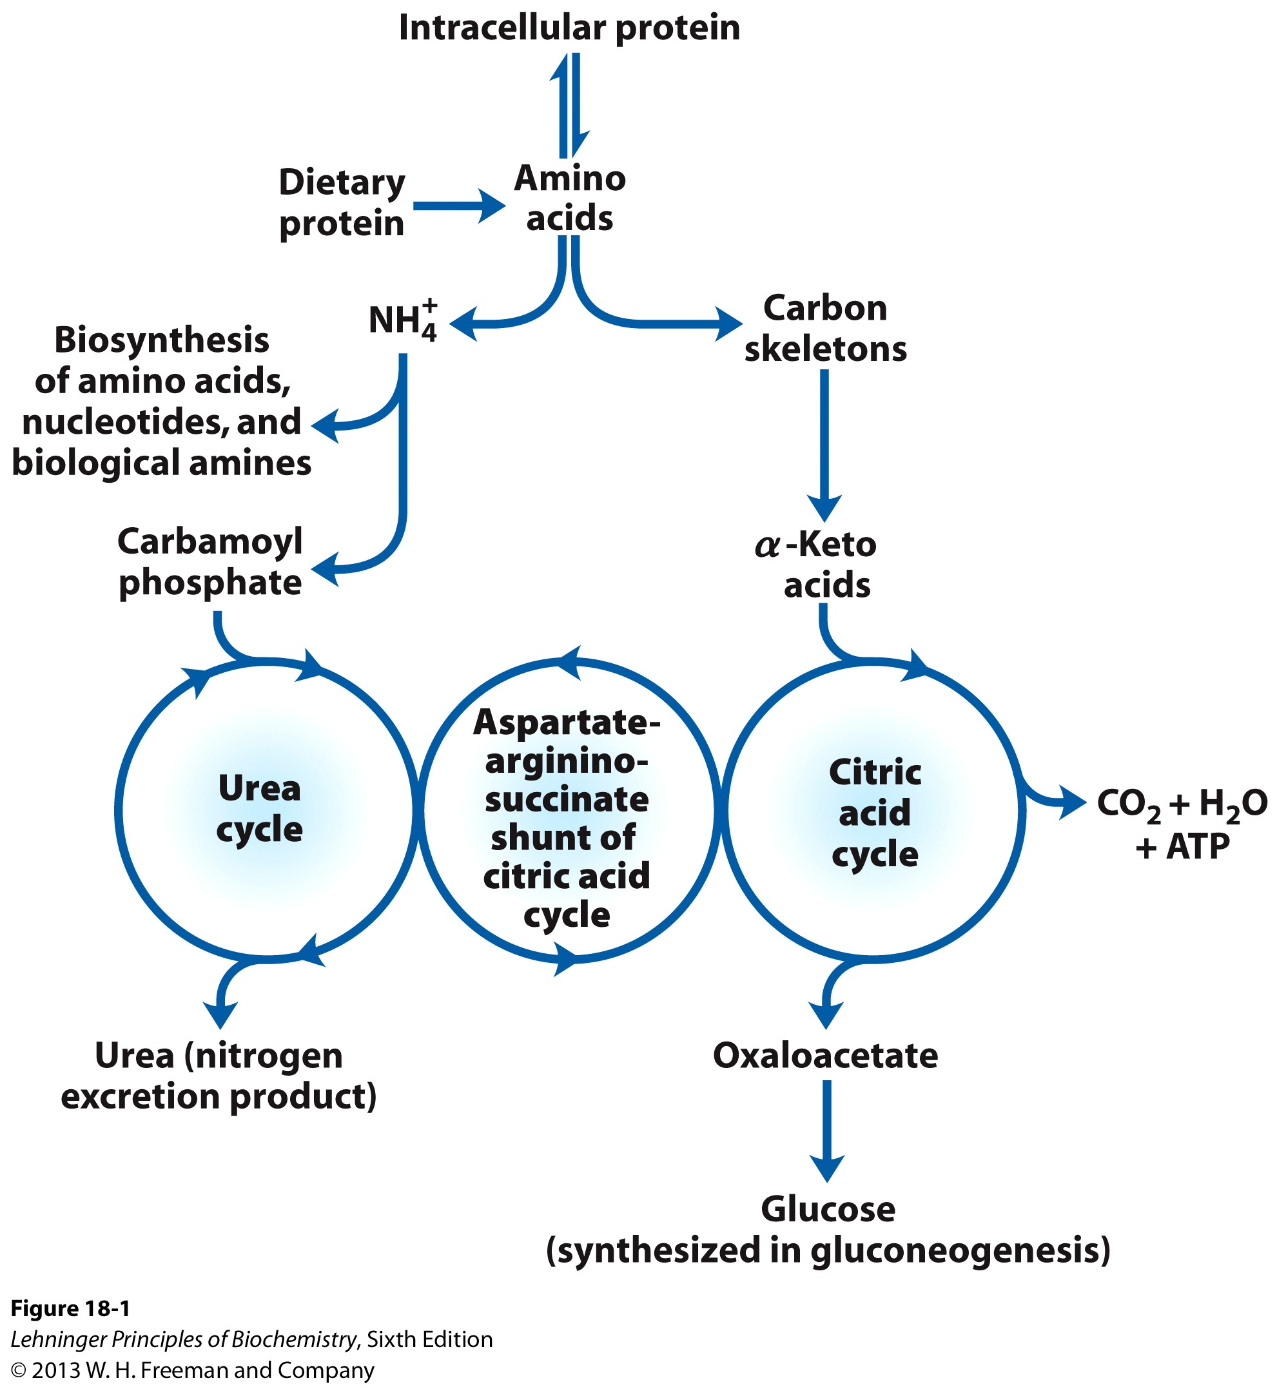
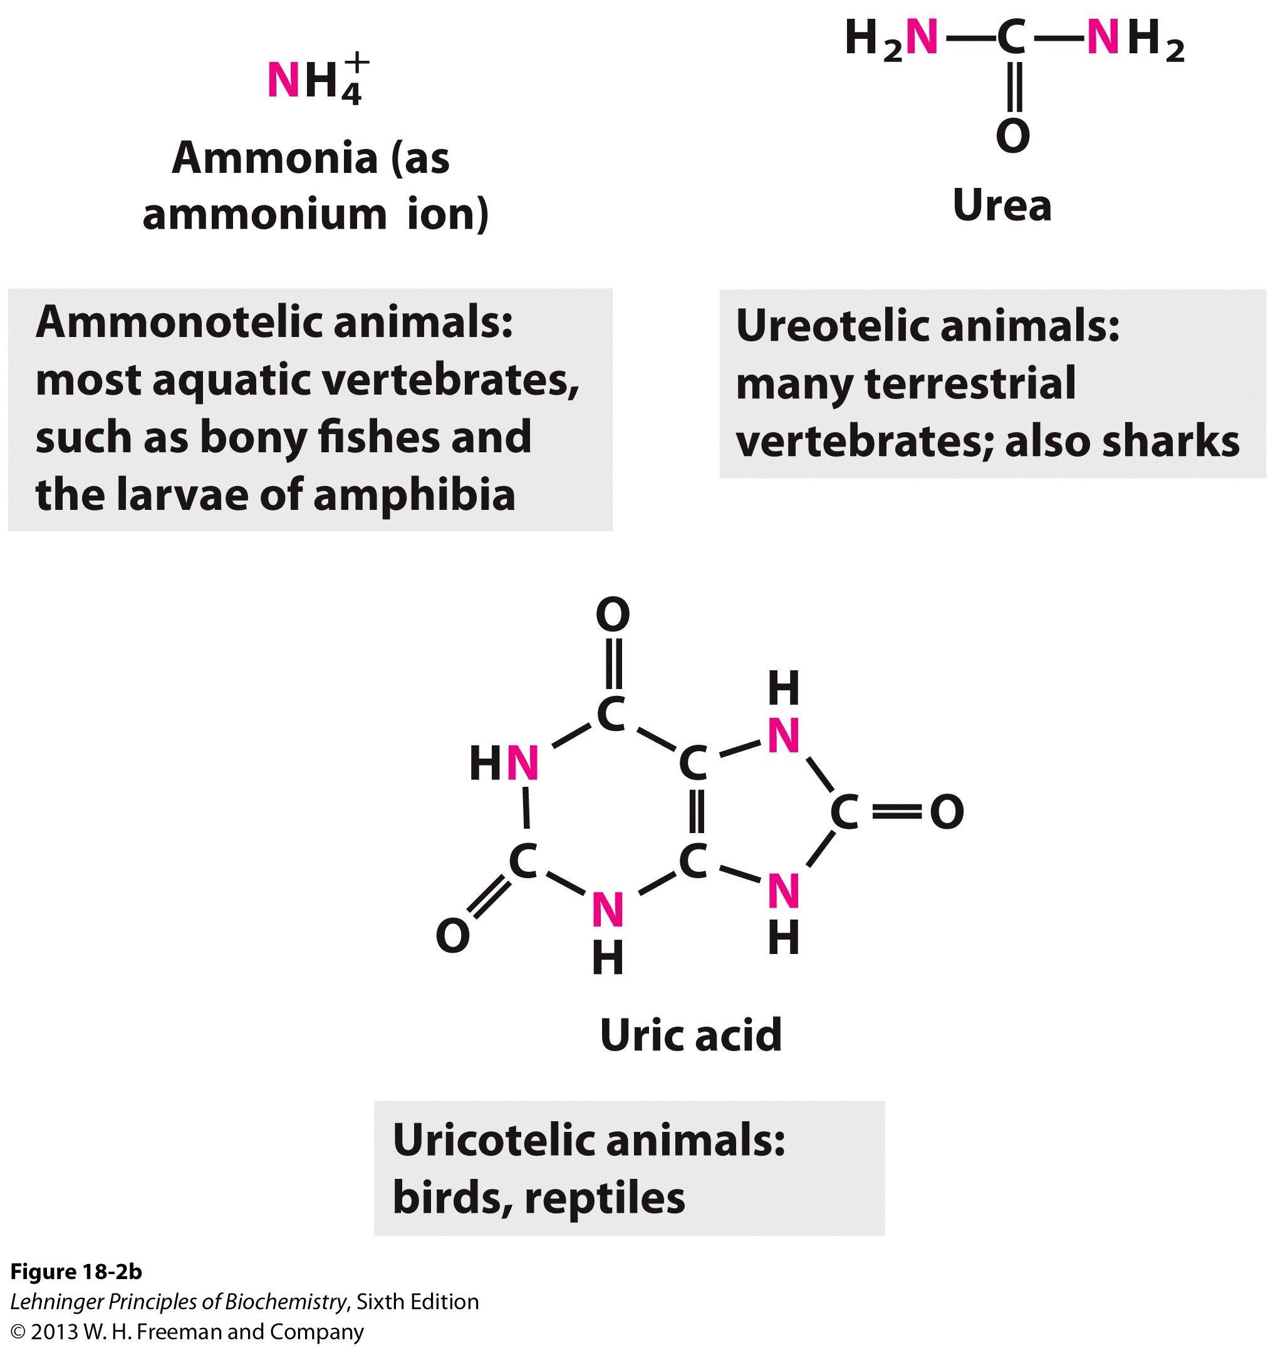
Overview of amino acid catabolism

Slide 6
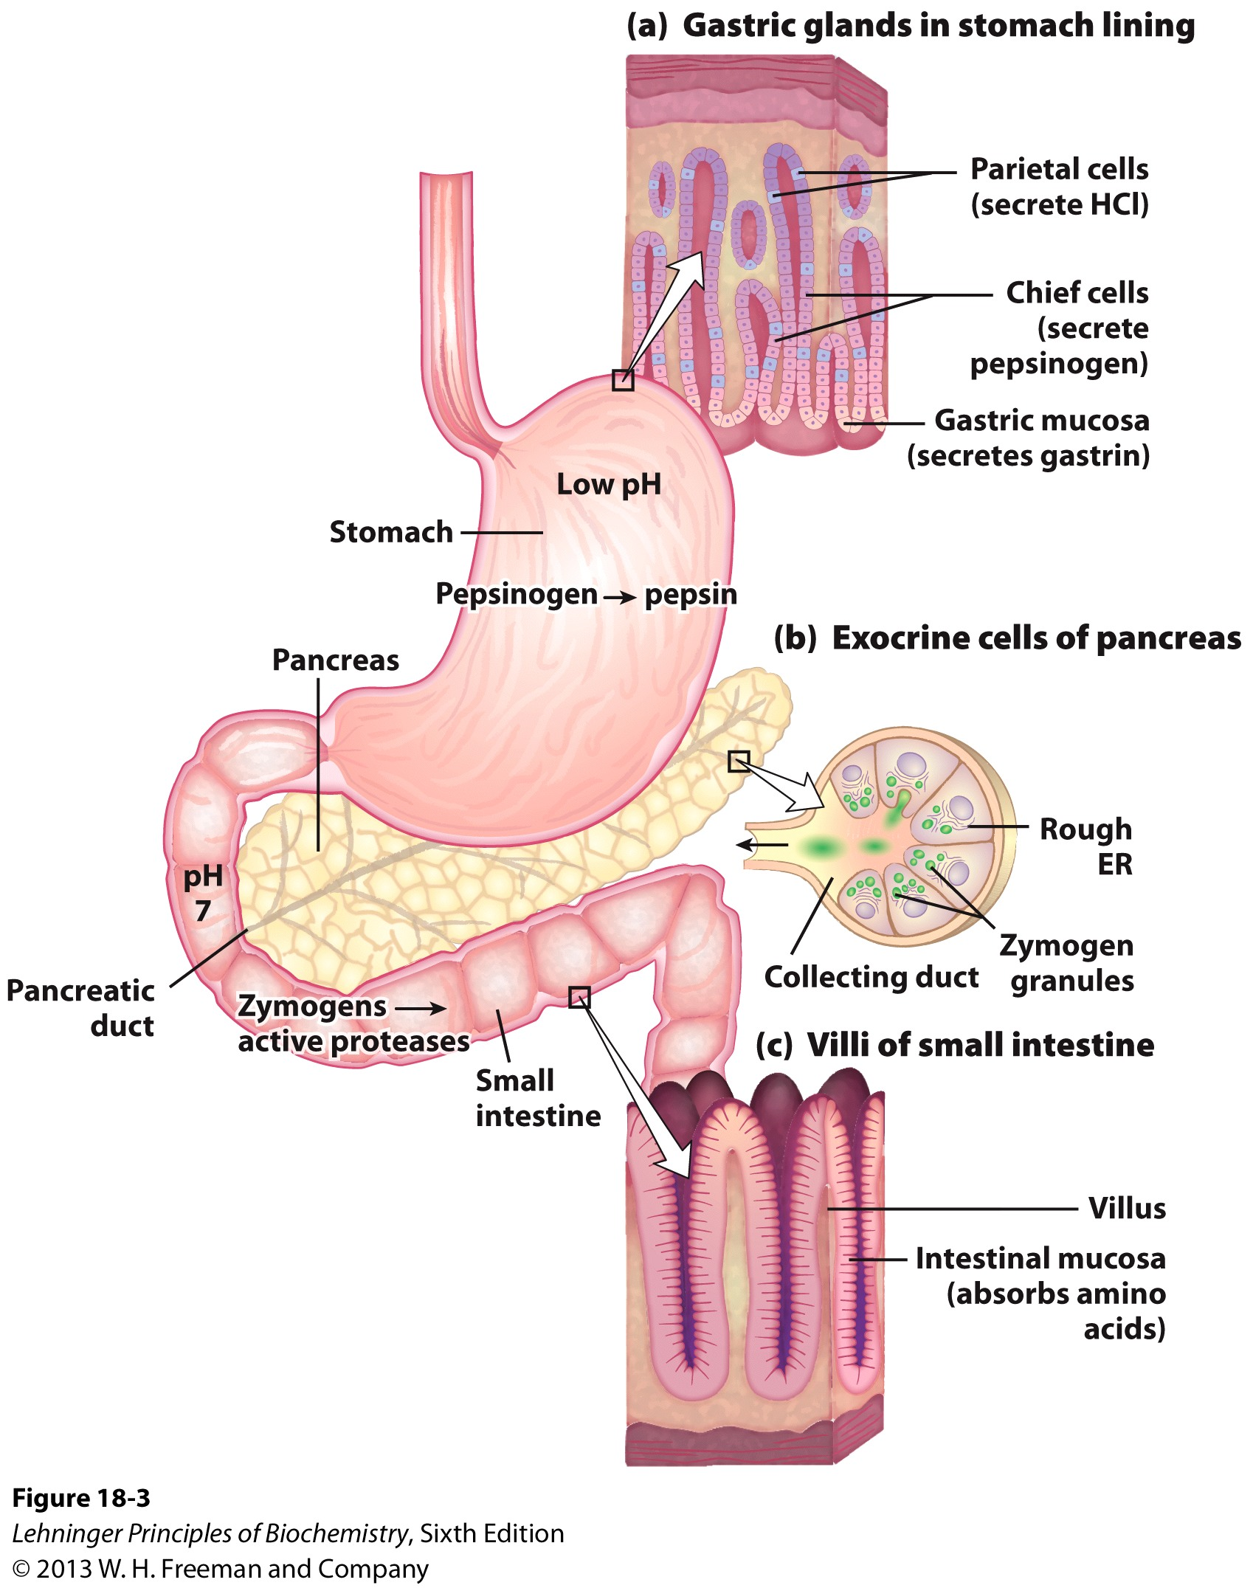
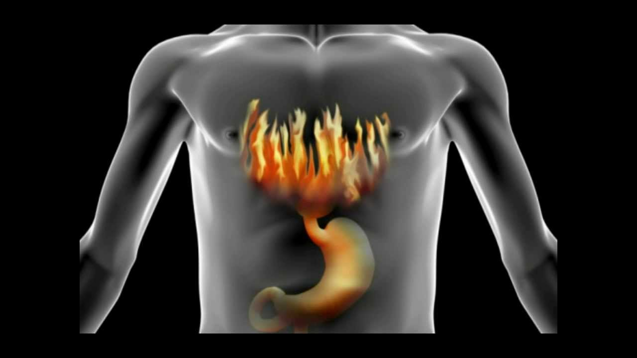
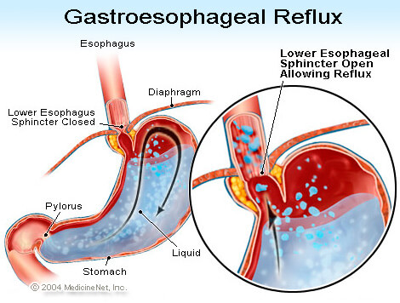
Digestion of dietary proteins

Slide 7
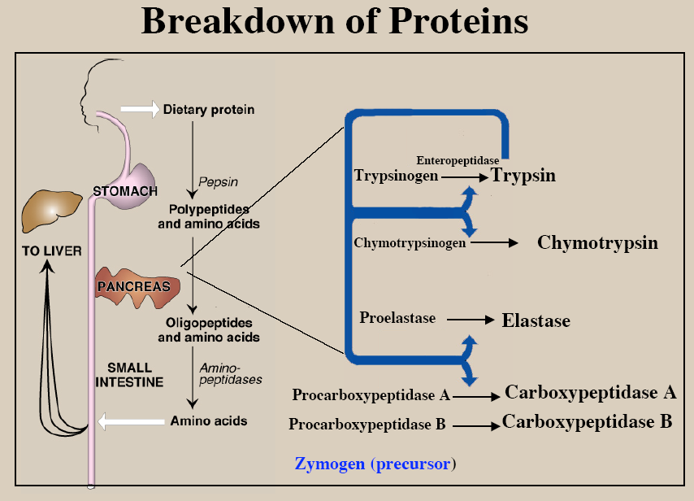

Slide 8
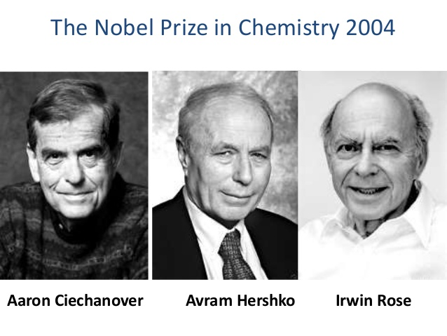
Degradation of intracellular proteins by the ubiquitin-proteasome system
E1: Ubiquitin activating enzyme
E2: Ubiquitin conjugating enzyme
E3: Ubiquitin-Protein ligase

Slide 9
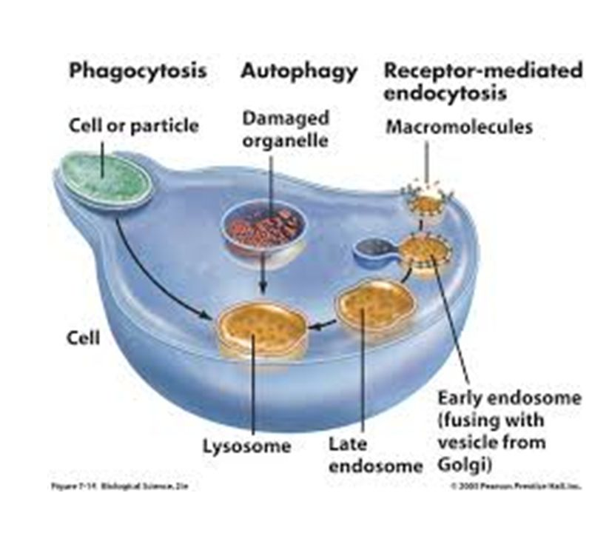
Endo-lysosome also mediates protein degradation and recycling
Lysosome under EM

Slide 10
Overview of amino acid catabolism
Carboxyl group
Removal of the amino groups by transamination
The leftover carbon skeletons are converted to common intermediates of energy-producing pathways.
Amino group

Slide 11
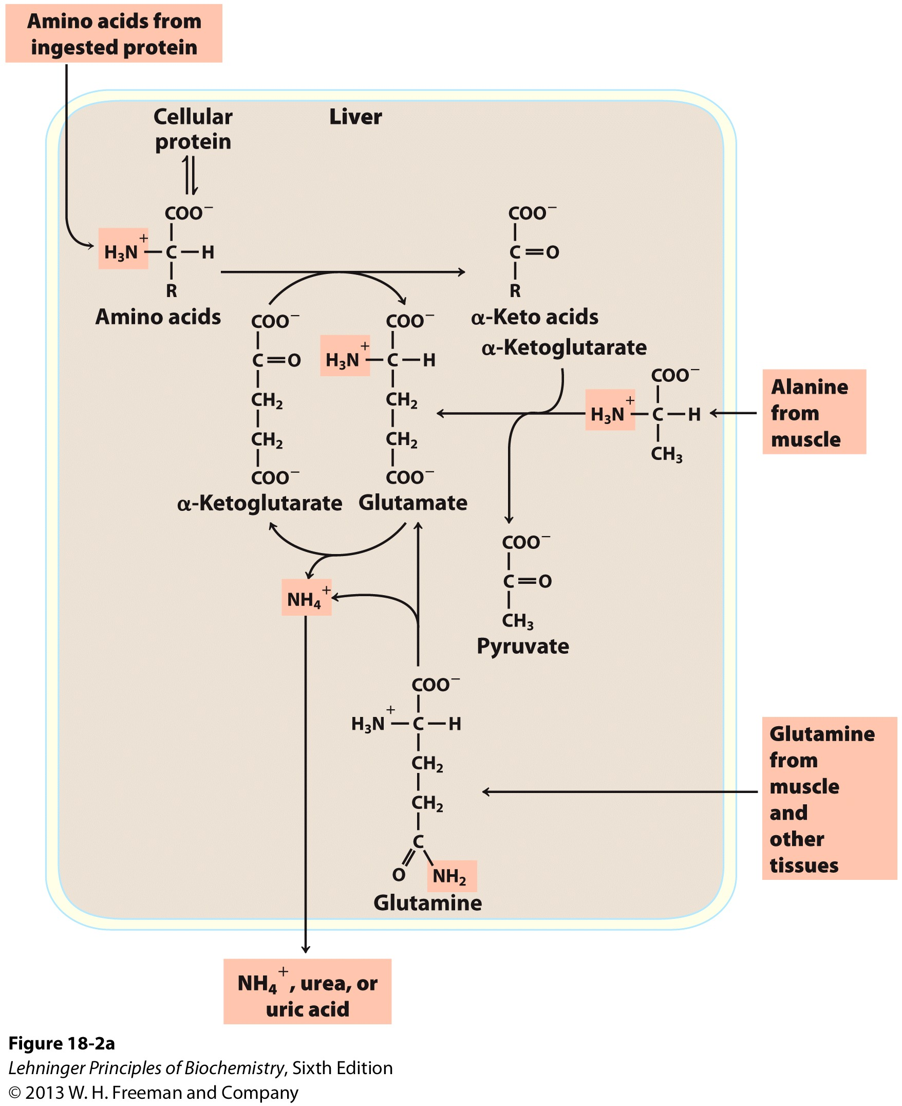
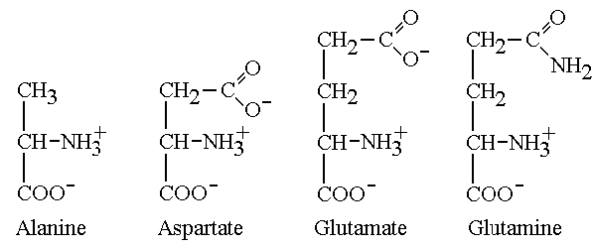
Trans-deamination mediates amine removal
Four amino acids of particular importance in AA catabolism

Slide 12
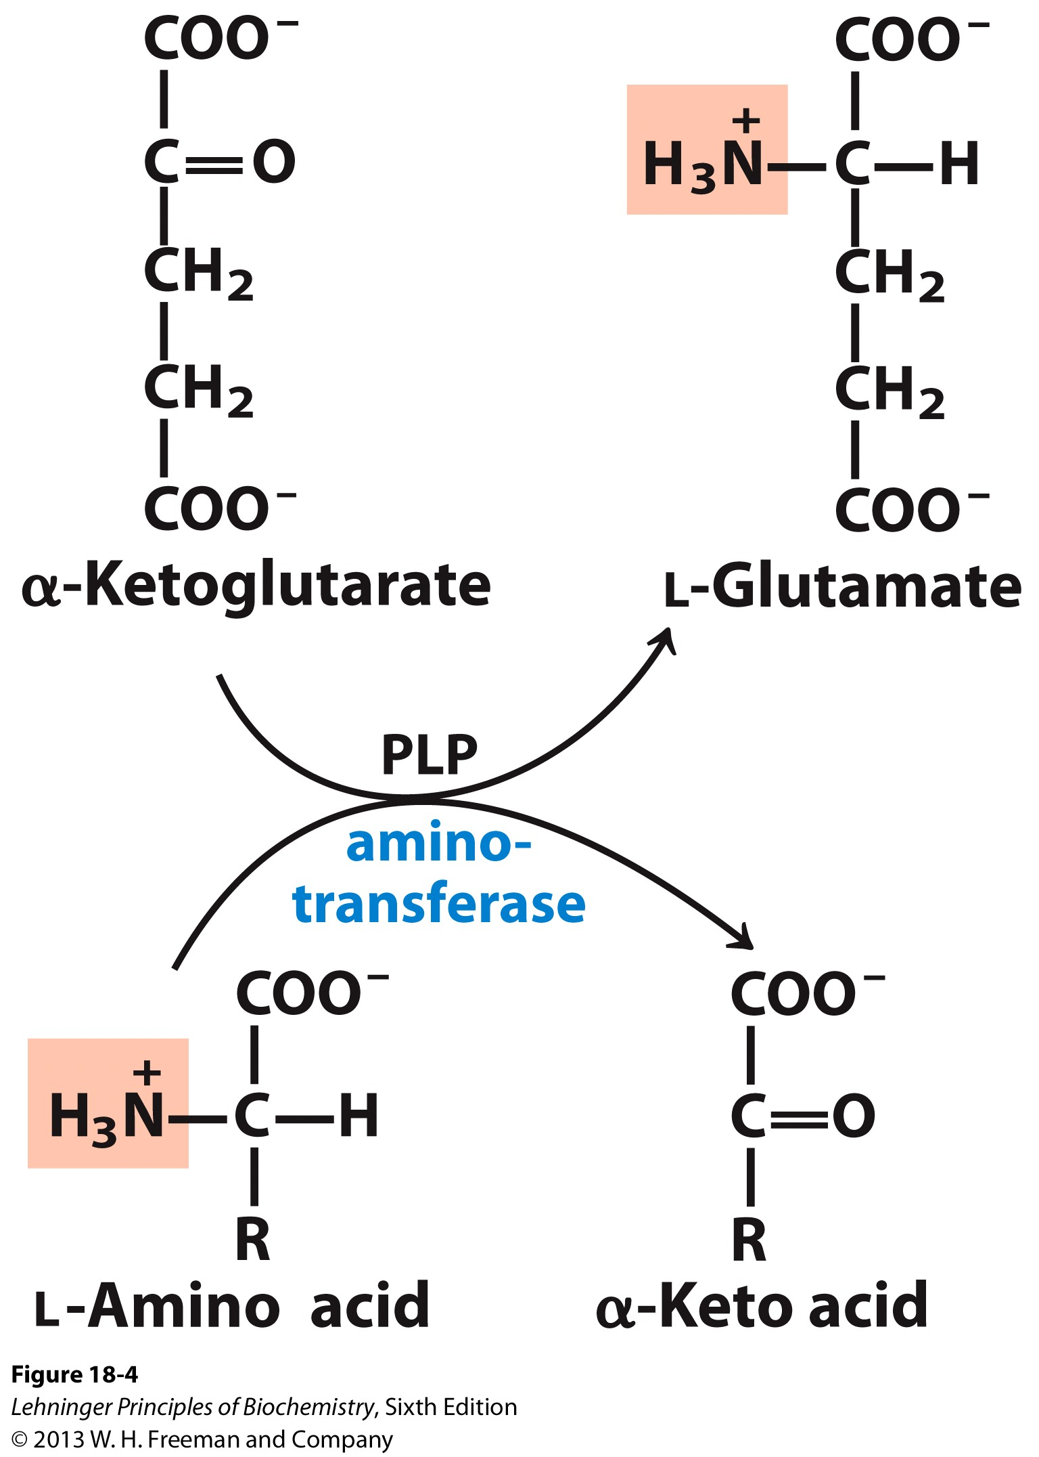
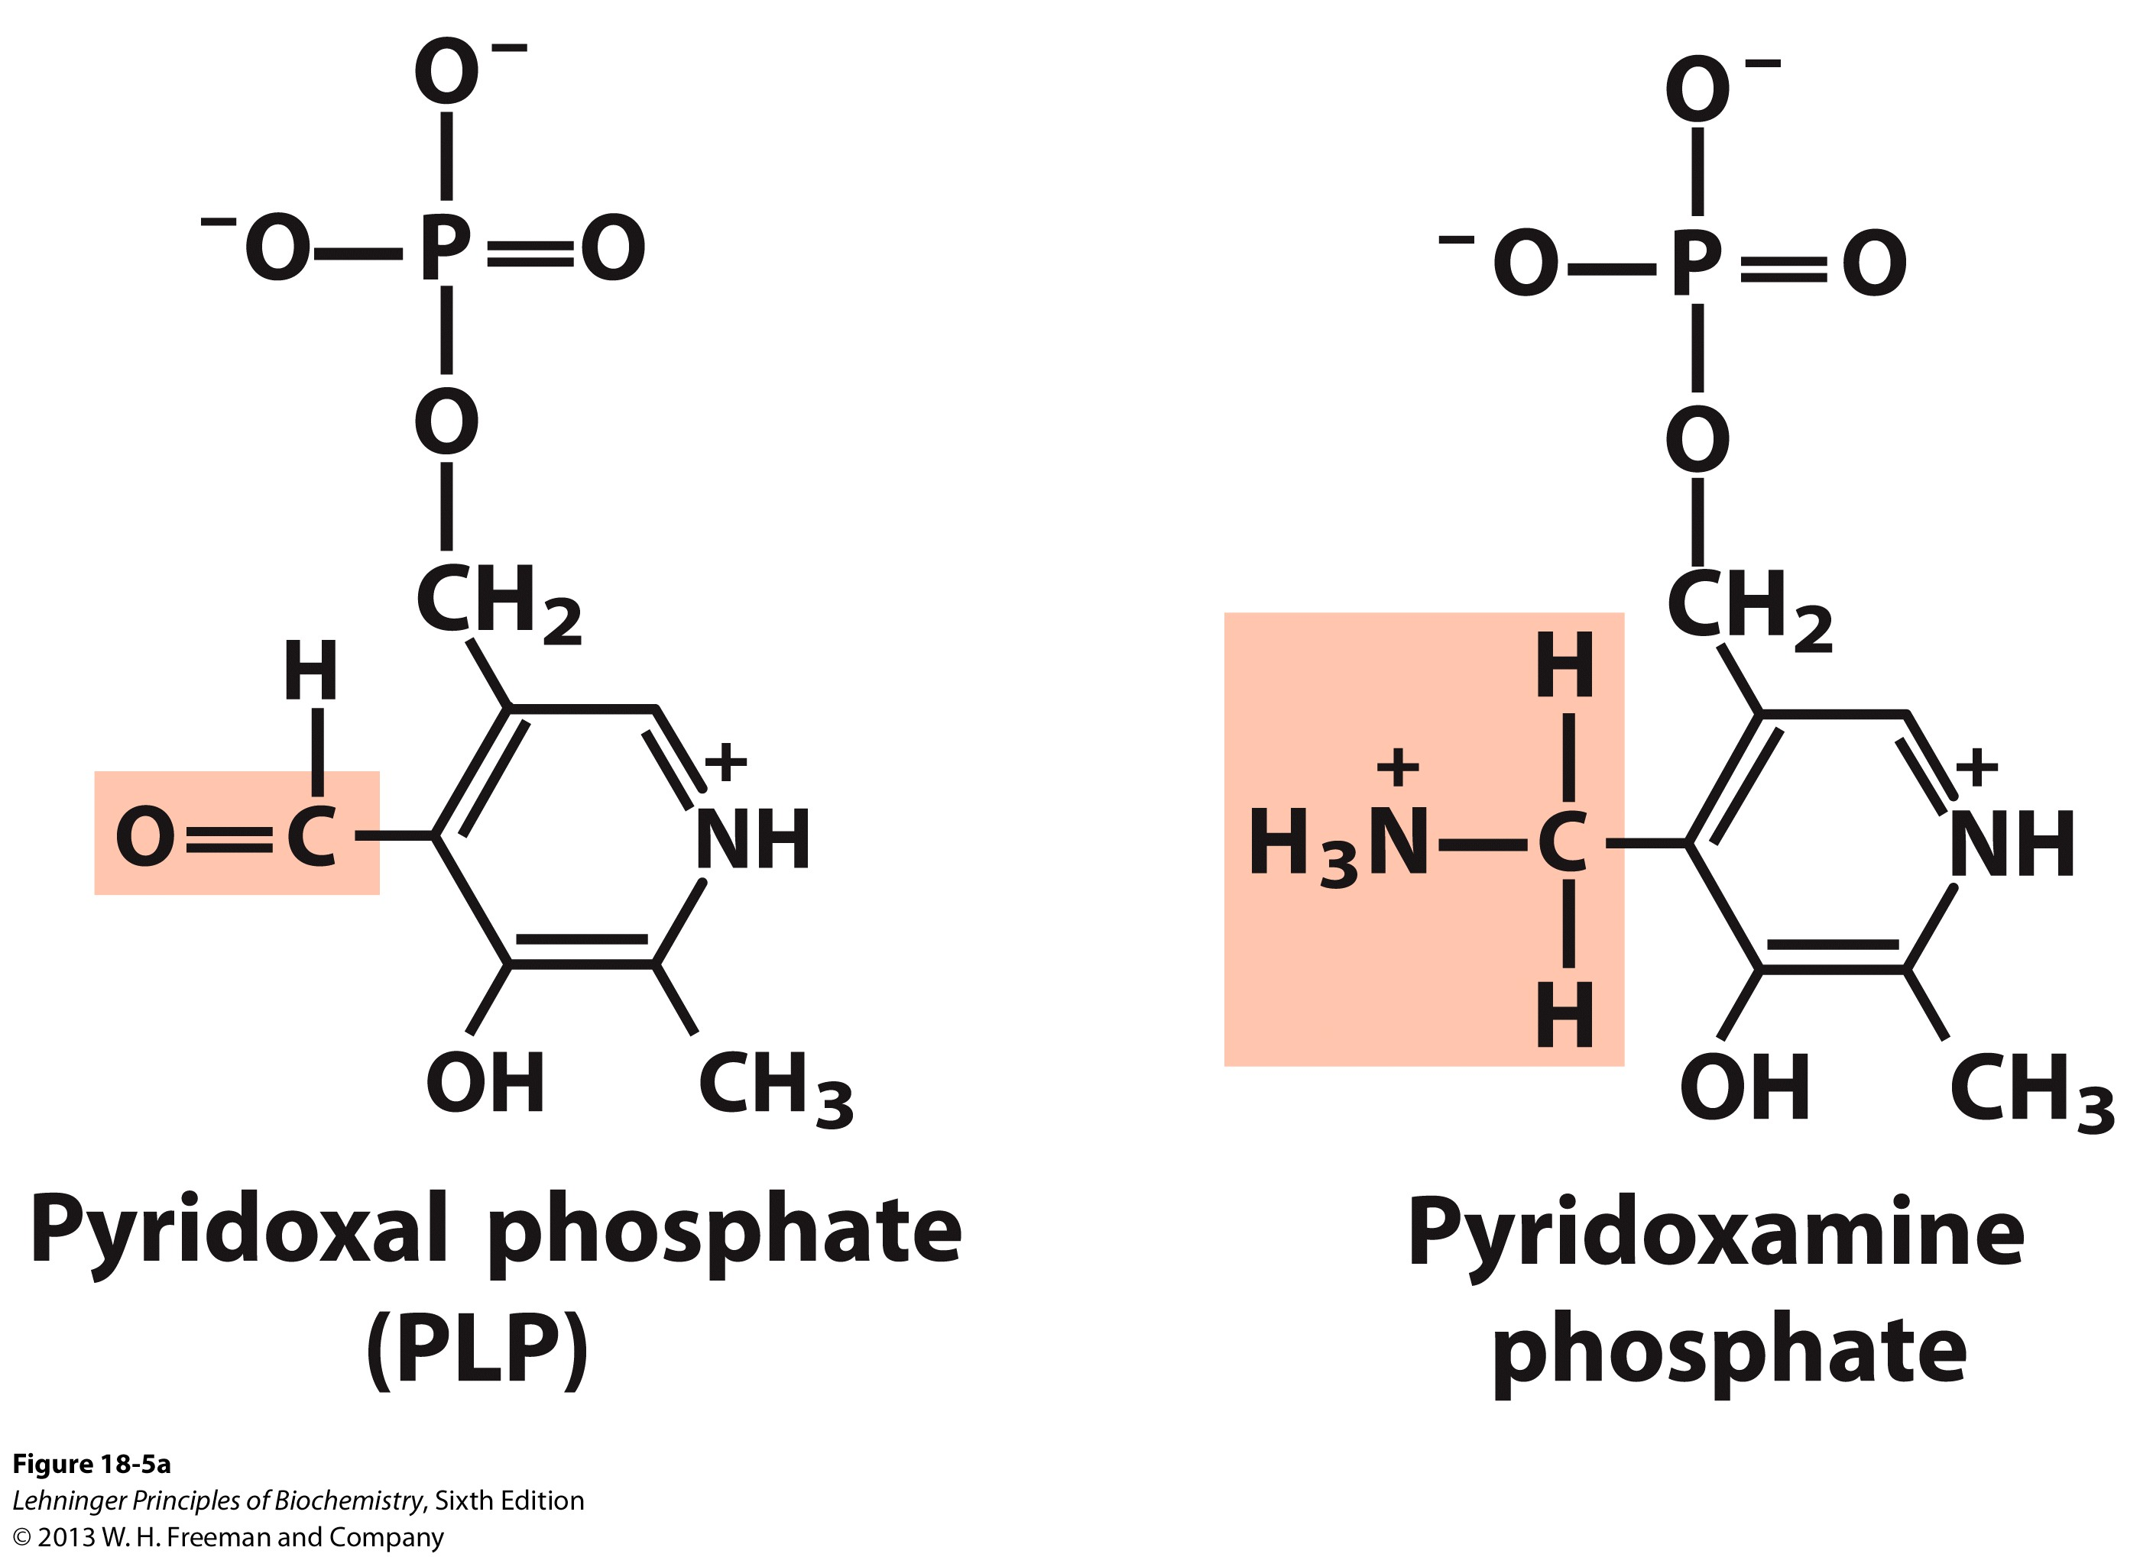
Aminotransferases (transaminases) transfer amino groups from an amino acid to Glutamate

Slide 13
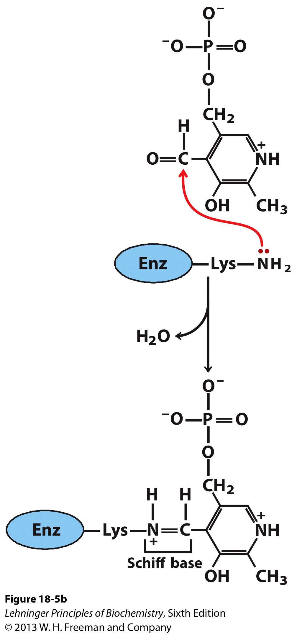
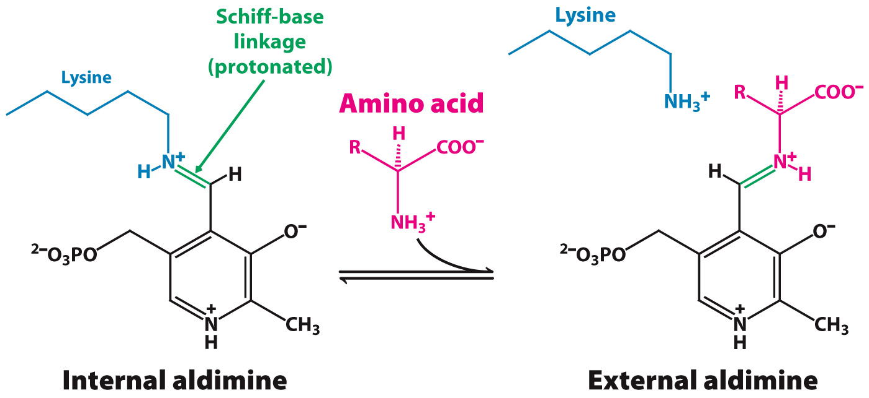
PLP functions as an intermediate carrier of amino groups at the active site of aminotransferases
A Schiff base is a compound with the general structure R₂C=NR' (R' ≠ H)
PLP forms a Schiff-base linkage with the ε-amino group at the enzyme active site. A new Schiff-base linkage occurs upon amino acid binding. An internal aldimine is replaced with an external aldimine.

Slide 14
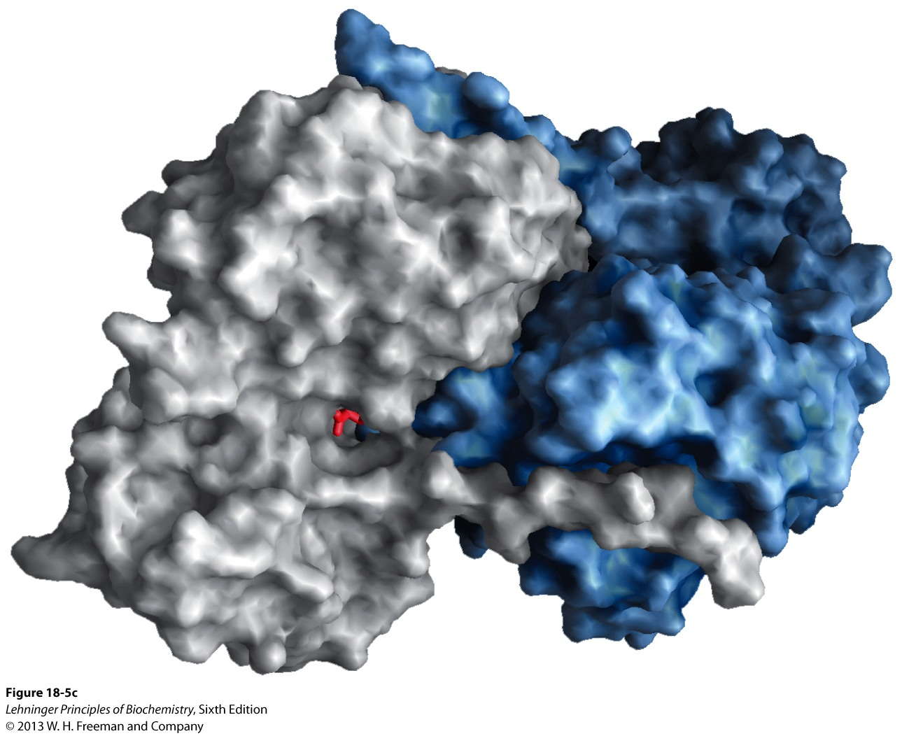
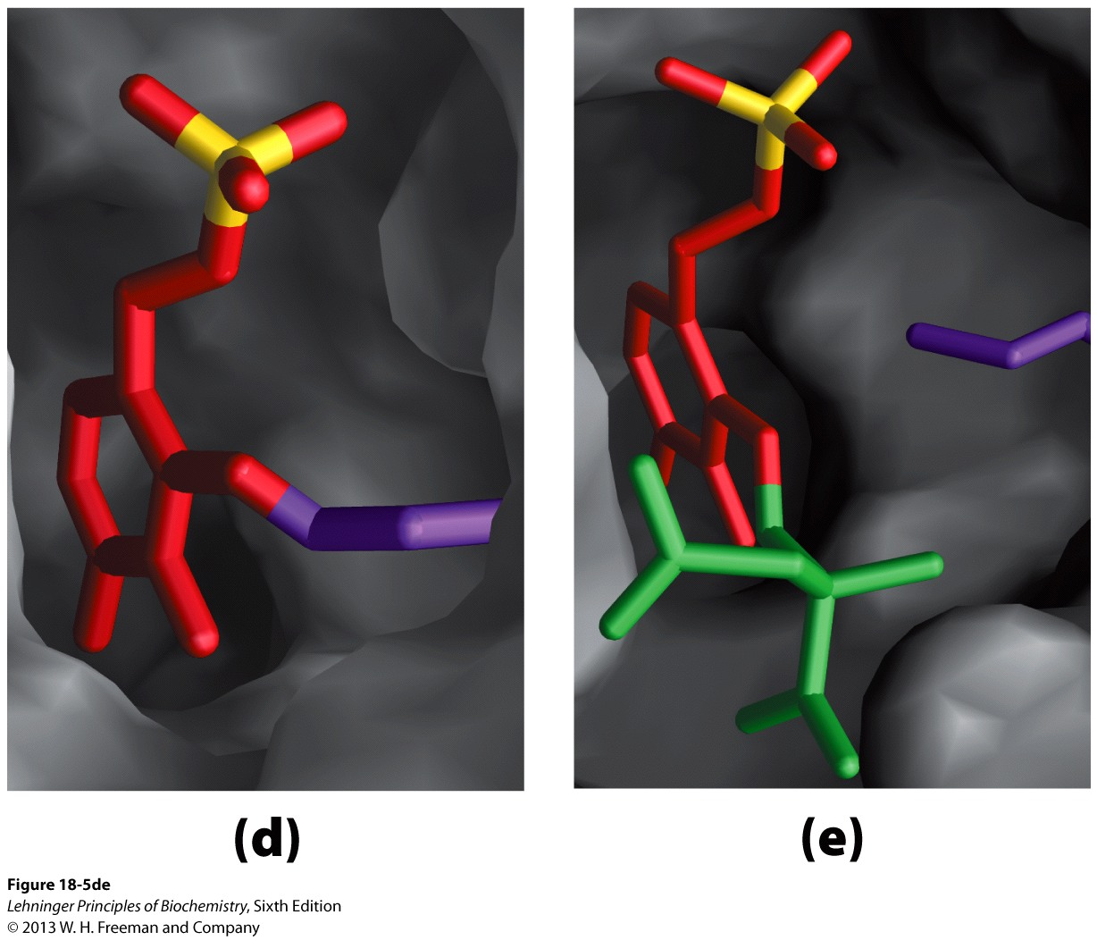
Aspartate aminotransferase is an archetypal pyridoxal-dependent aminotransferase
Mitochondrial aspartate aminotransferase functions as a dimer.
PLP is bound to lysine 258 in a Schiff-base linkage.
PLP is found in a pocket near the interface of the two subunits.

Slide 15
Different aminotransferases differ in their substrate preference
Alanine aminotransferase (ALT)
Aspartate aminotransferase (AST)

Slide 16
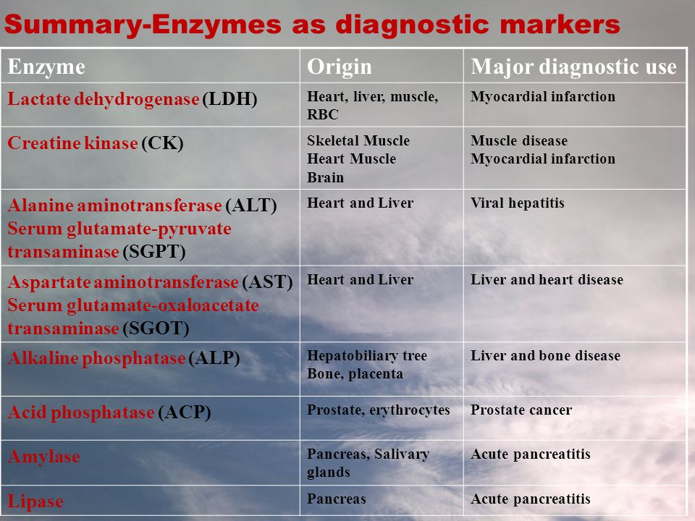
AST/ALT as markers for liver damage

Slide 17
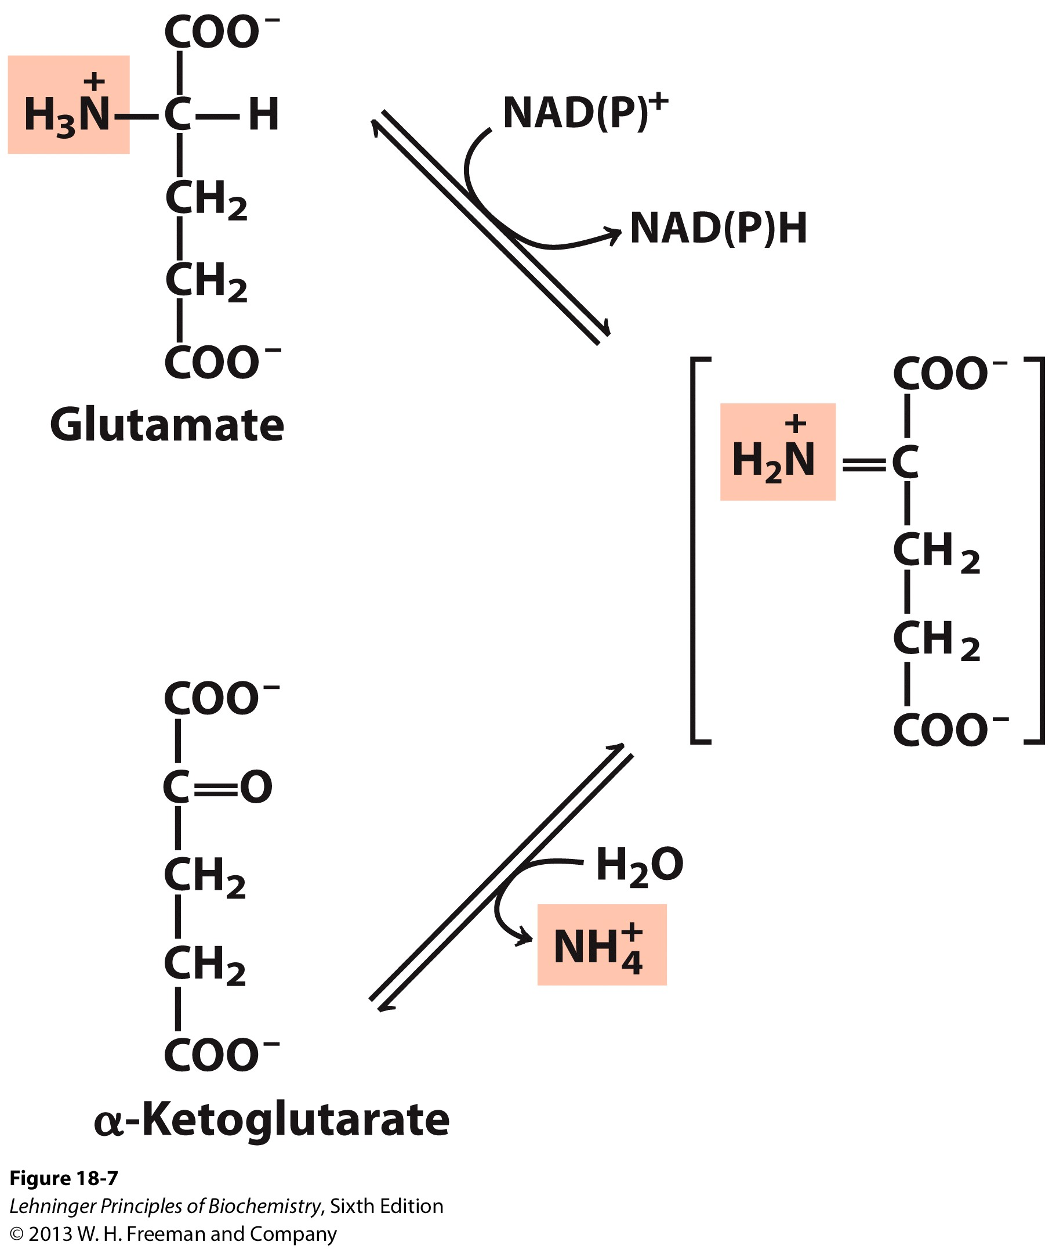
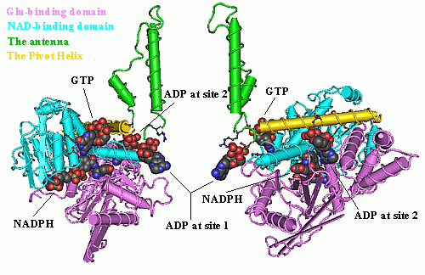
Glutamate dehydrogenase mediates oxidative deamination

Slide 18
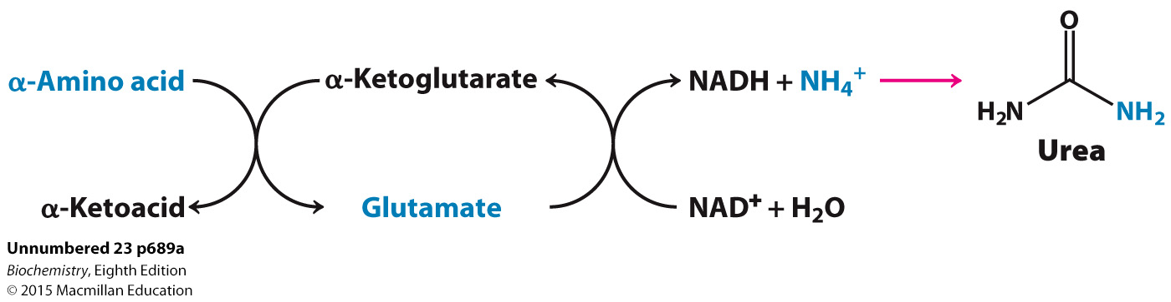
The combined action of an aminotransferase and glutamate dehydrogenase is referred to as transdeamination (trans-de-animation)
In terrestrial vertebrates, the ultimate fate of the NH₄⁺ is the formation of urea.

Slide 19
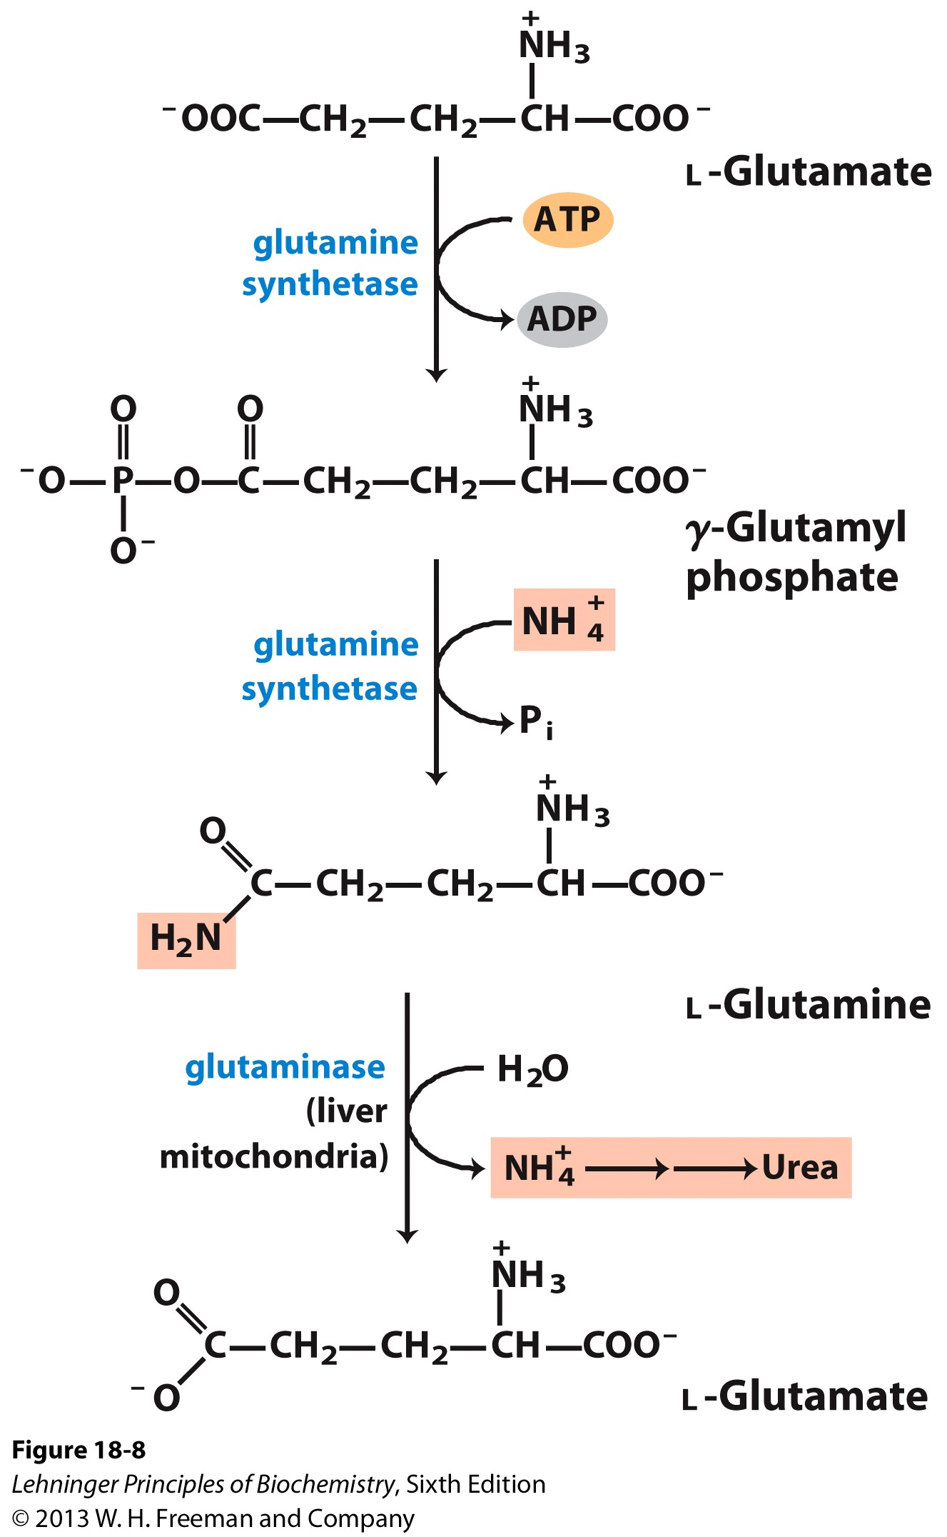
Glutamine transports ammonia in the bloodstream
Glutamine is the most abundant free AA in the circulation.
“Glutamine addiction”: many tumor cells consume a large amount of glutamine.

Slide 20
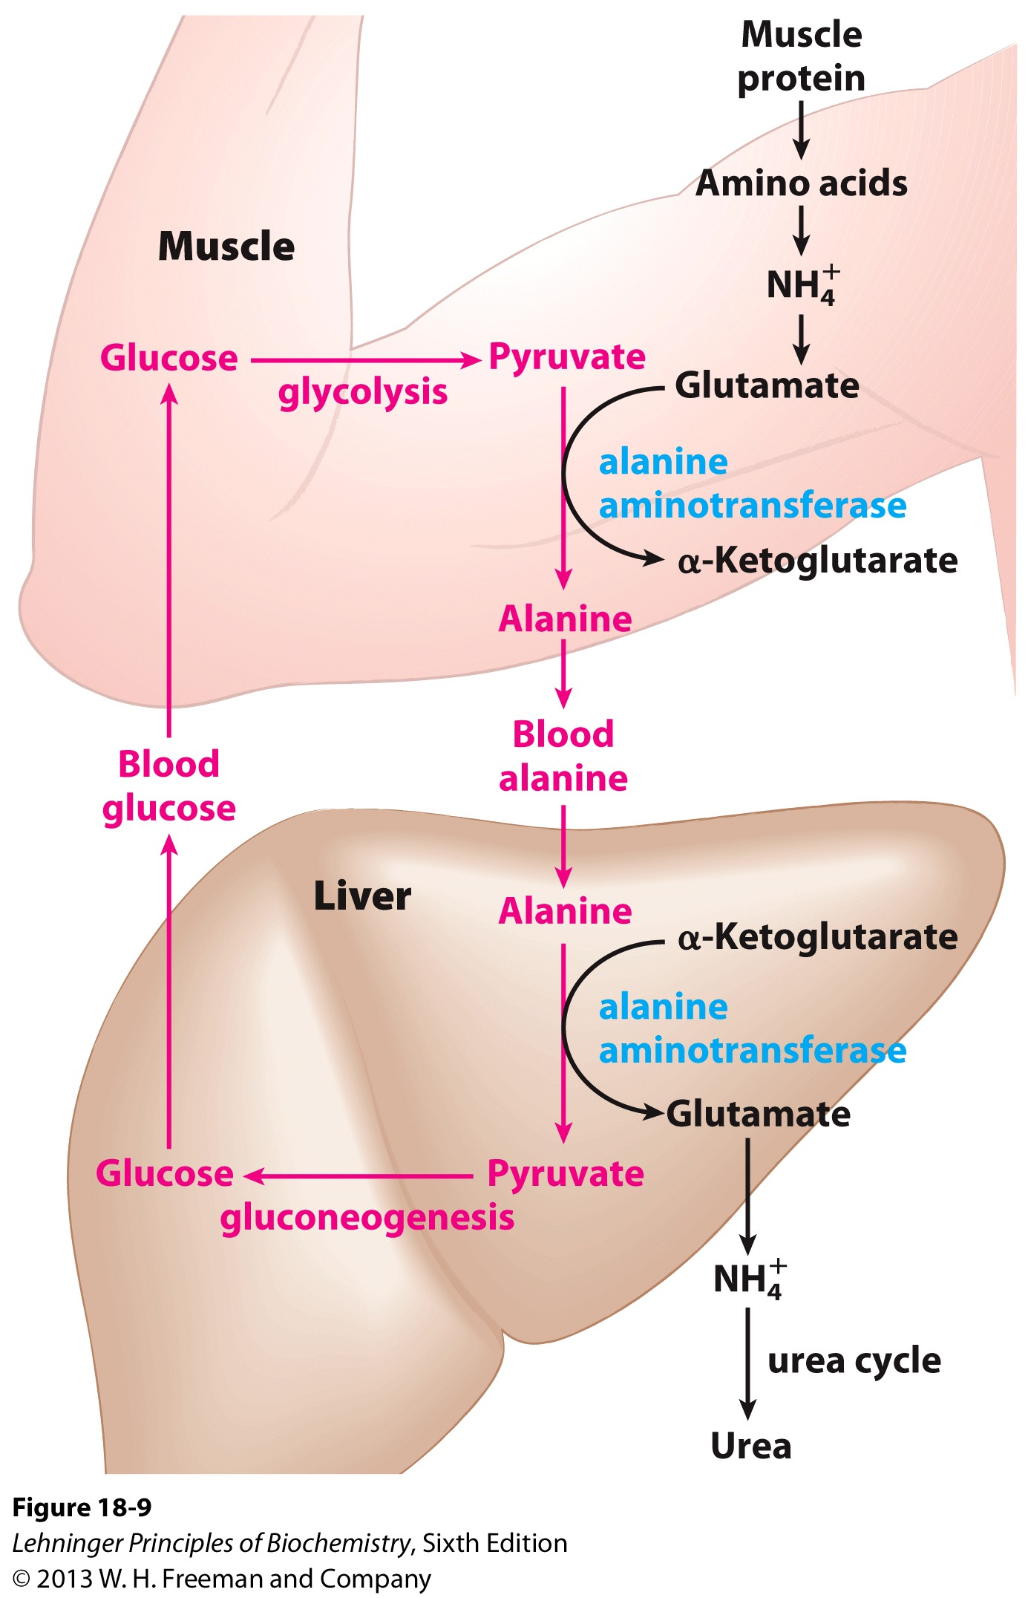
Glucose-alanine cycle brings both carbon and nitrogen from muscle to liver
Vigorous exercise consumes a lot of energy.
Glucose level needs to be maintained, by gluconeogenesis in the liver. (Cori cycle to shuttle lactate in exchange for glucose)
Amino acids from muscle proteins are also consumed.

Slide 21
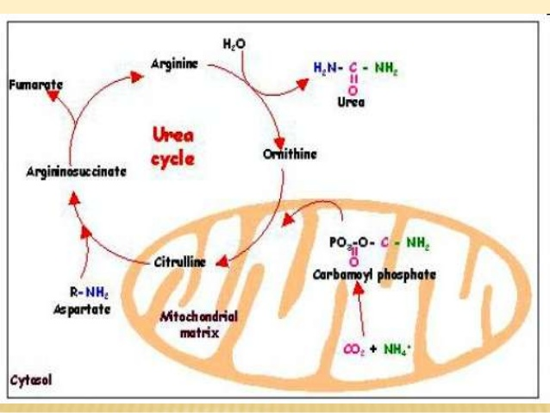
The urea cycle happens in both mitochondria and cytosol

Slide 22
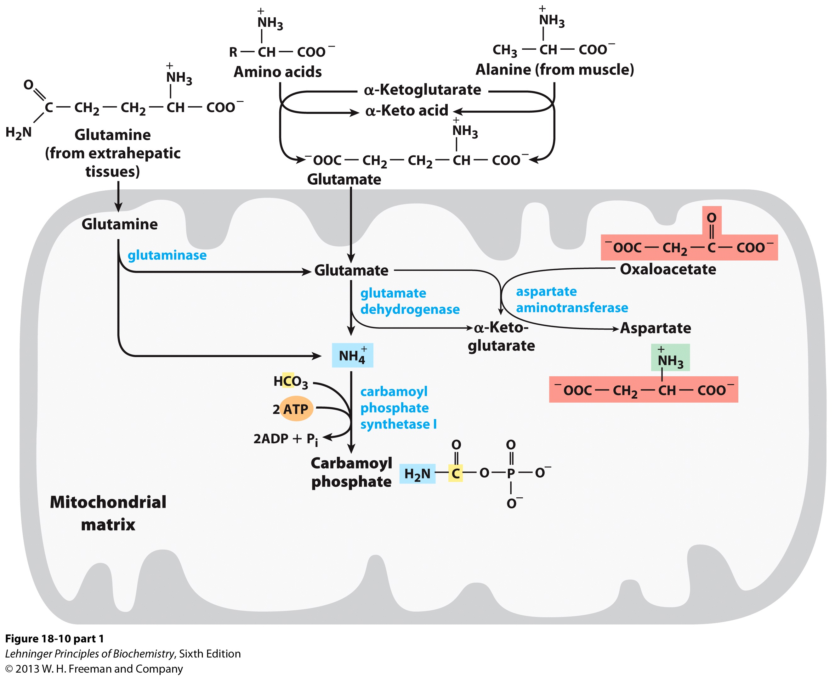
Stage 1: Production of carbamoyl phosphate (activation of ammonium)

Slide 23
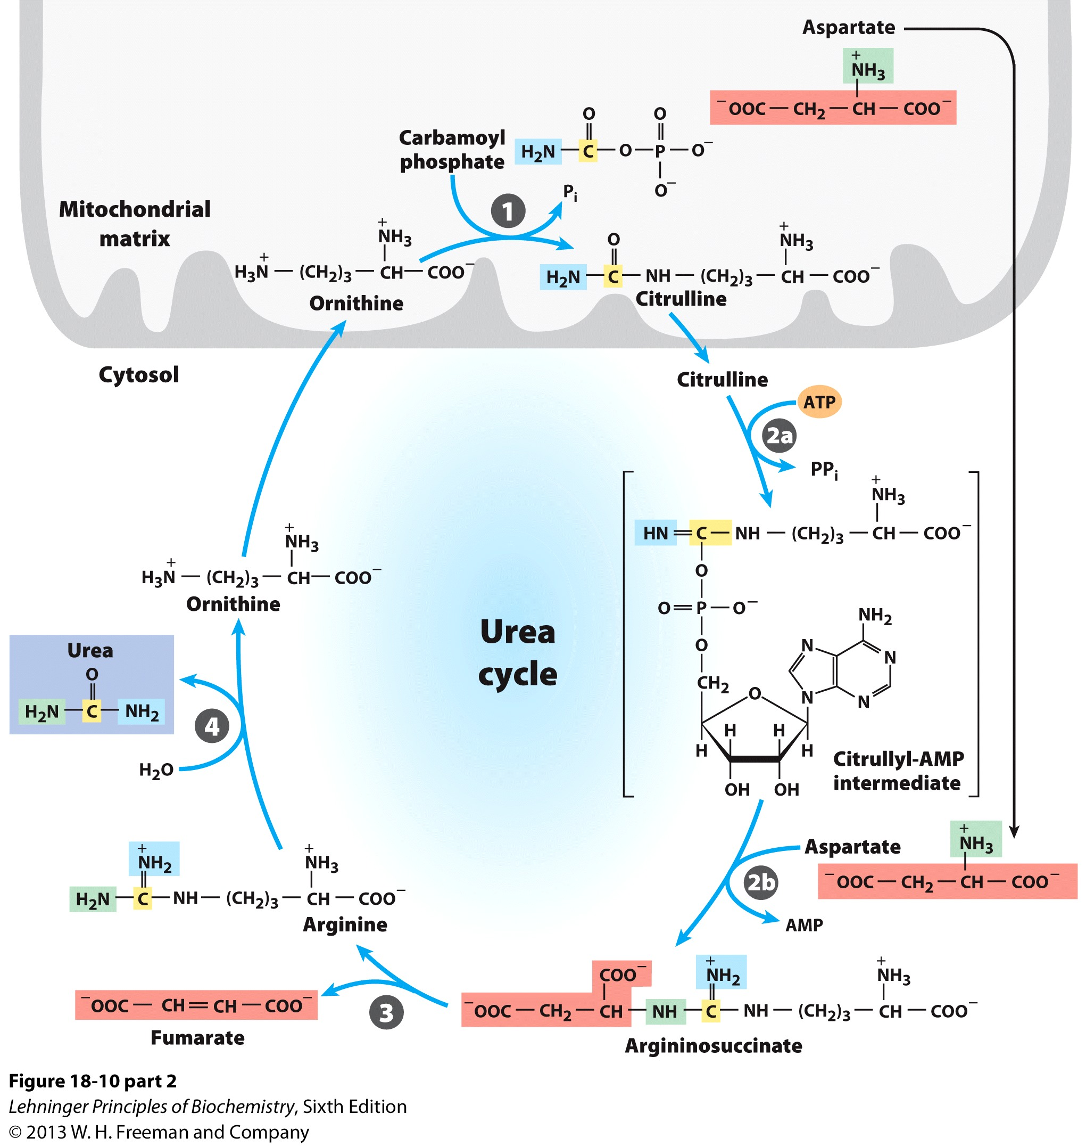
Stage 2: The production and release of urea
(the actual urea cycle)

Slide 24
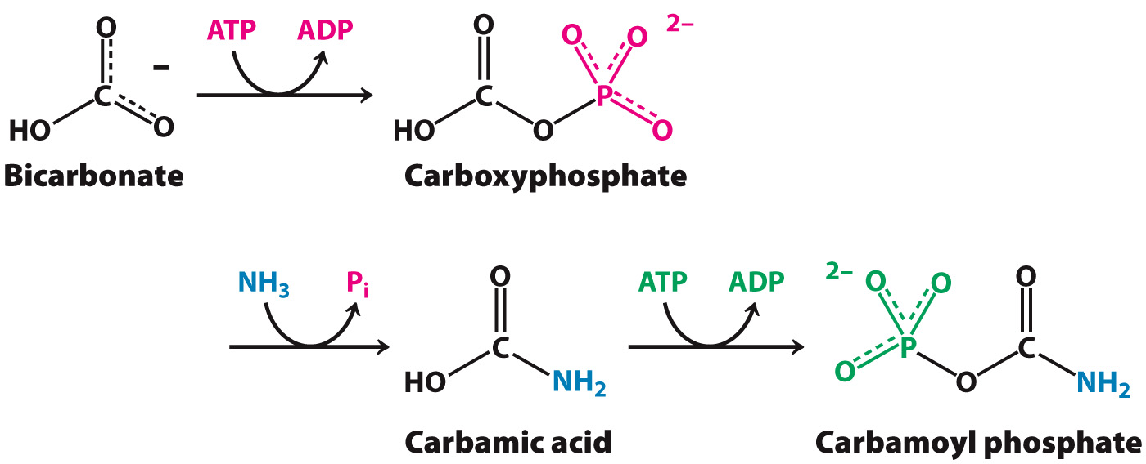
Step 1: coupling of ammonia with bicarbonate, catalyzed by carbamoyl phosphate synthetase (CPS I)
The committed step in the urea cycle

Slide 25
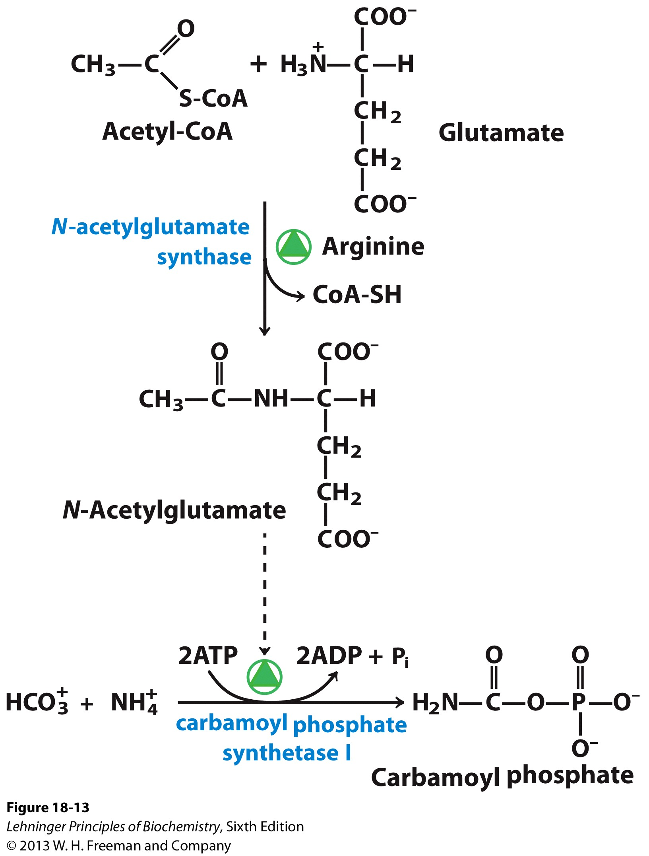
Carbamoyl phosphate synthetase requires N-acetylglutamate (NAG) for activity

Slide 26
Stage 2: The production and release of urea
(the actual urea cycle)
Ornithine Translocase,
also transports Citrullin, Arginine, etc.

Slide 27
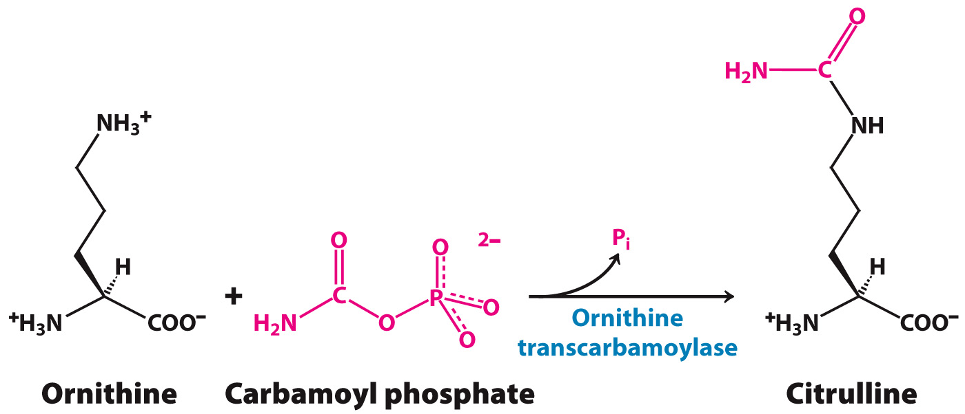
Step 2: Carbamoyl phosphate reacts with ornithine to form citrulline
Citrulline is transported out of the mitochondria into the cytoplasm in exchange for ornithine.

Slide 28
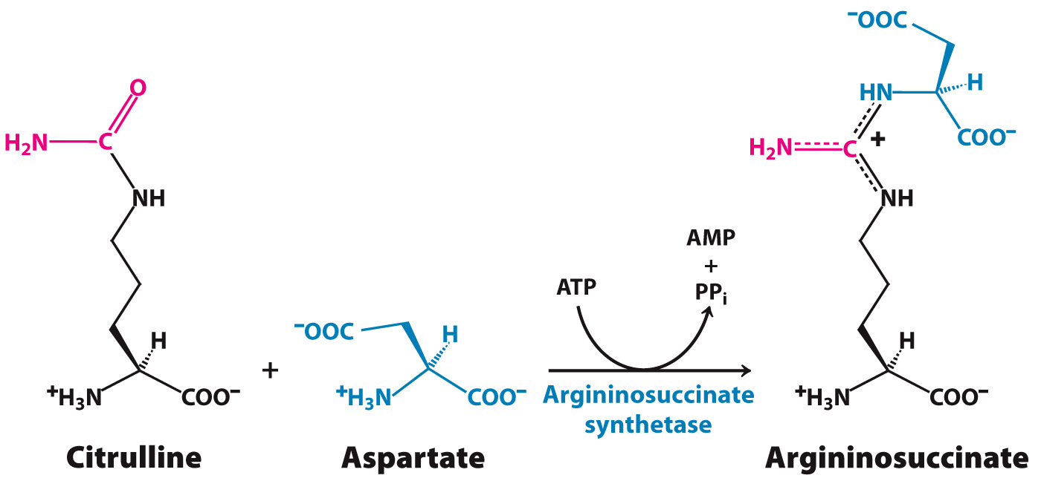
Step 3: Citrulline condenses with aspartate to form argininosuccinate
A citrullyl-AMP intermediate is involved

Slide 29
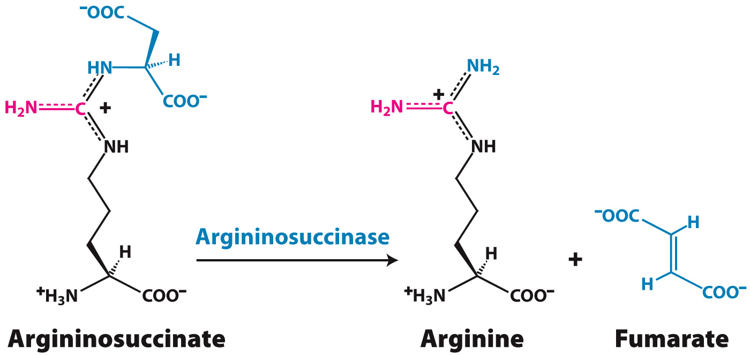
Step 4: Argininosuccinate is cleaved into arginine and fumarate
Fumarate is converted to malate before entering the mitochondria and the citric acid cycle.

Slide 30
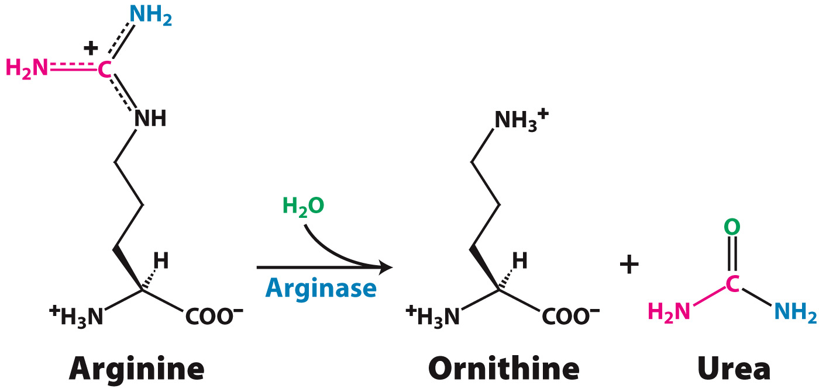
Step 5: Arginine is cleaved by arginase into urea
Ornithine is transported into the mitochondrion to initiate another round of the urea cycle.

Slide 31
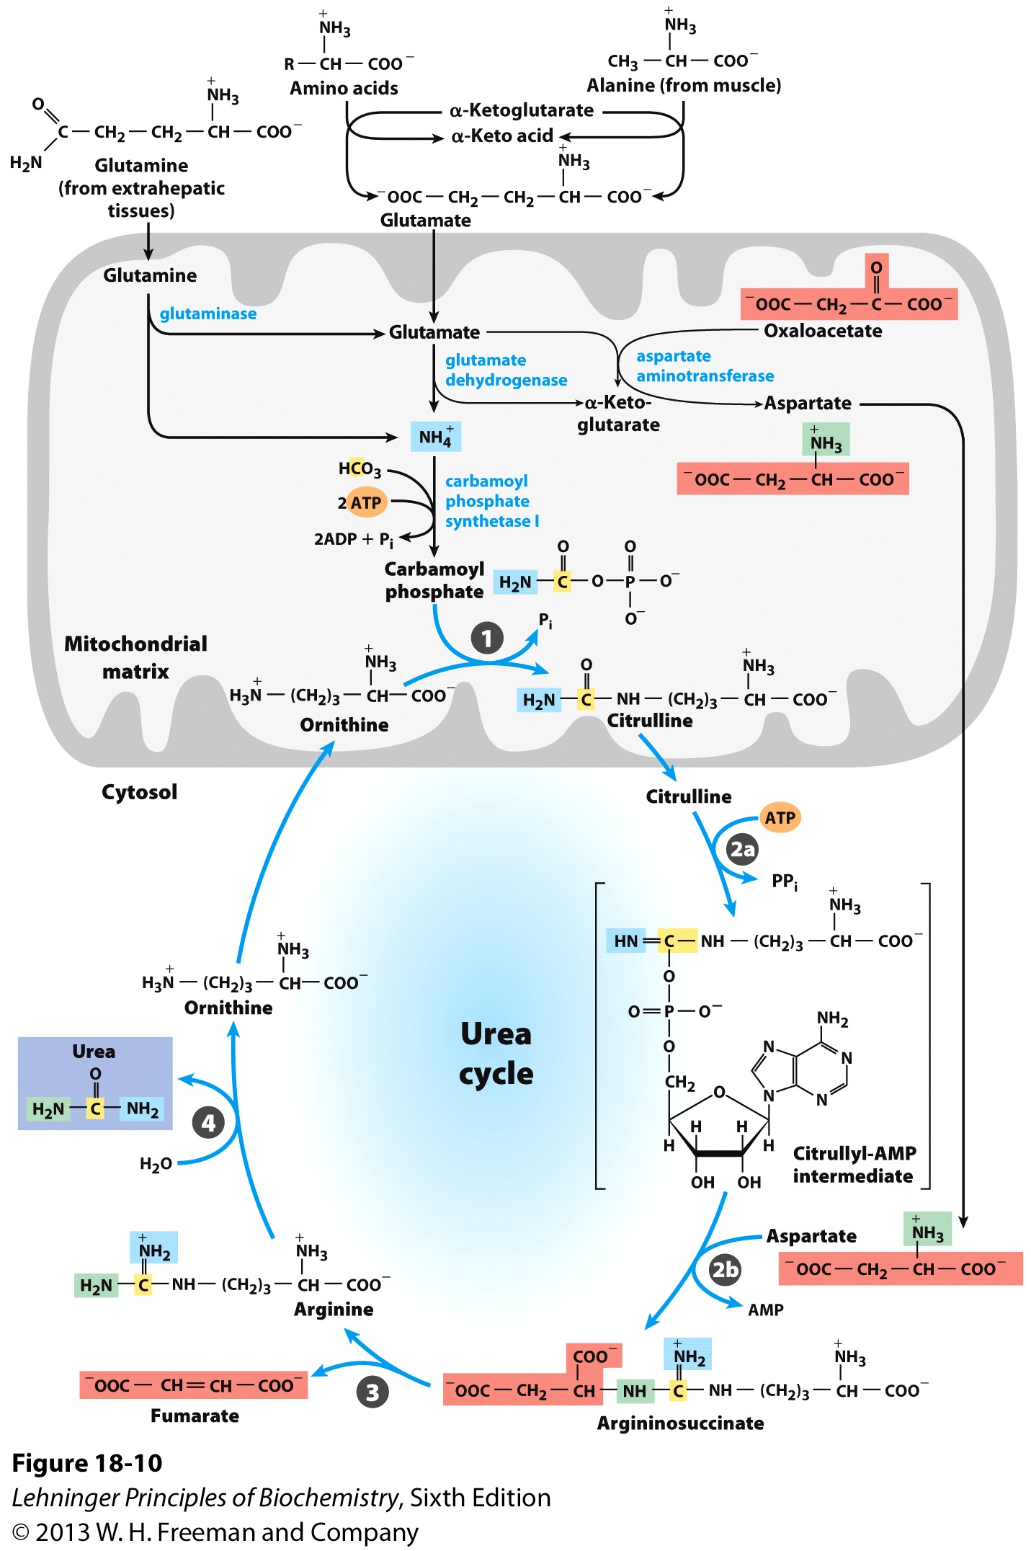
The urea cycle
Carbamoyl phosphate synthetase I
Ornithine transcarbamoylase
Argininosuccinate synthetase
Argininosuccinase
Arginase

Slide 32
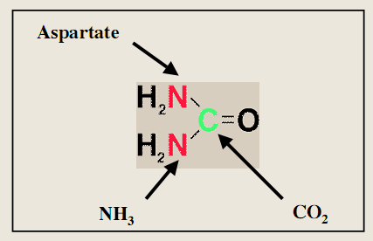
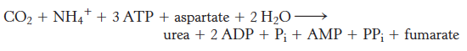
Overall reaction of urea cycle:
Urea consists of one nitrogen atom from aspartate, one nitrogen atom from NH₄⁺, and one carbon from CO₂.
Energy expensive disposal: 4 ATP (4 high-energy phosphate groups).
Regeneration of oxaloacetate produces NADH, which can generate up to 2.5 ATP during mitochondrial respiration.

Slide 33
Regulation of the urea cycle
Short term regulation
Long term regulation (expression of key enzymes)
Ornithine transcarbamoylase
Argininosuccinate synthetase
Argininosuccinase
Arginase

Slide 34
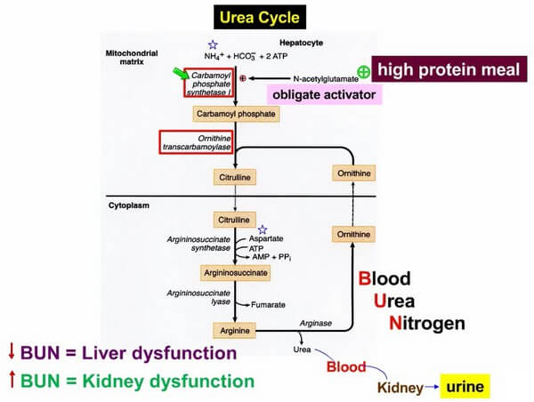
Deficiency of the urea cycle and diseases

Slide 35
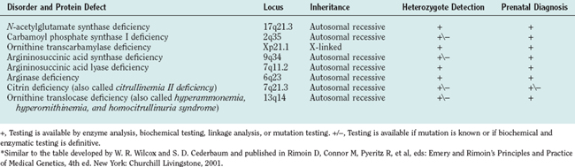
Urea cycle deficiency
Anything can go wrong will!
Citrin encodes a mitochondria transporter for Aspartate and glutamate

Slide 36
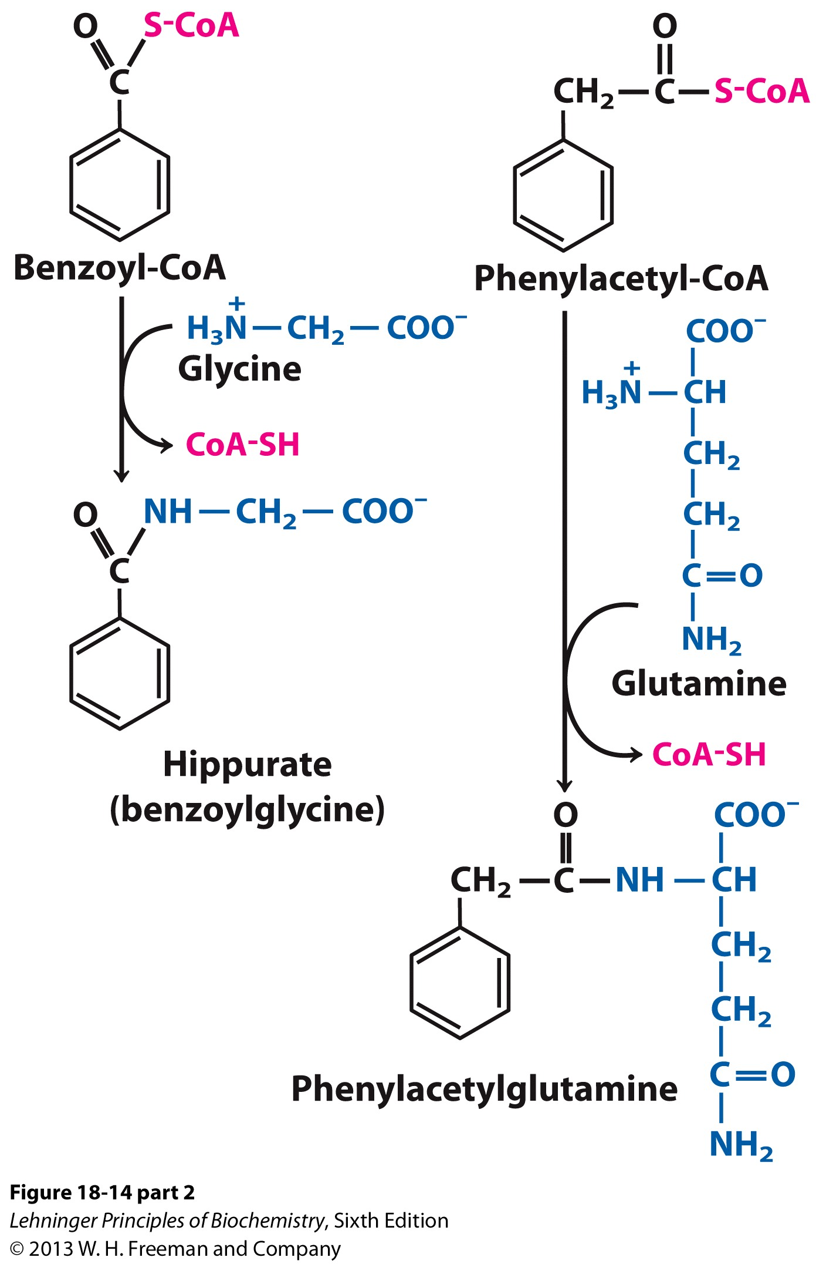
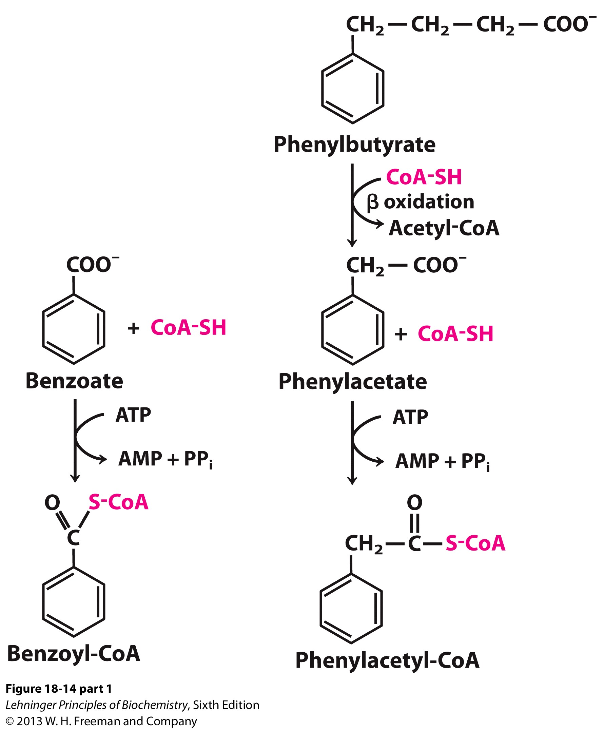
Treatment of urea cycle deficiency
(to reduce ammonium)
Excreted by the kidney

Slide 37
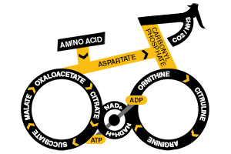
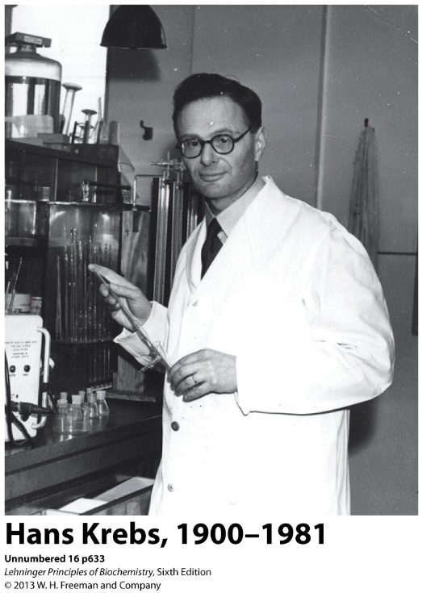
Connection between the urea cycle and TCA cycle
Krebs bicycle

Slide 38
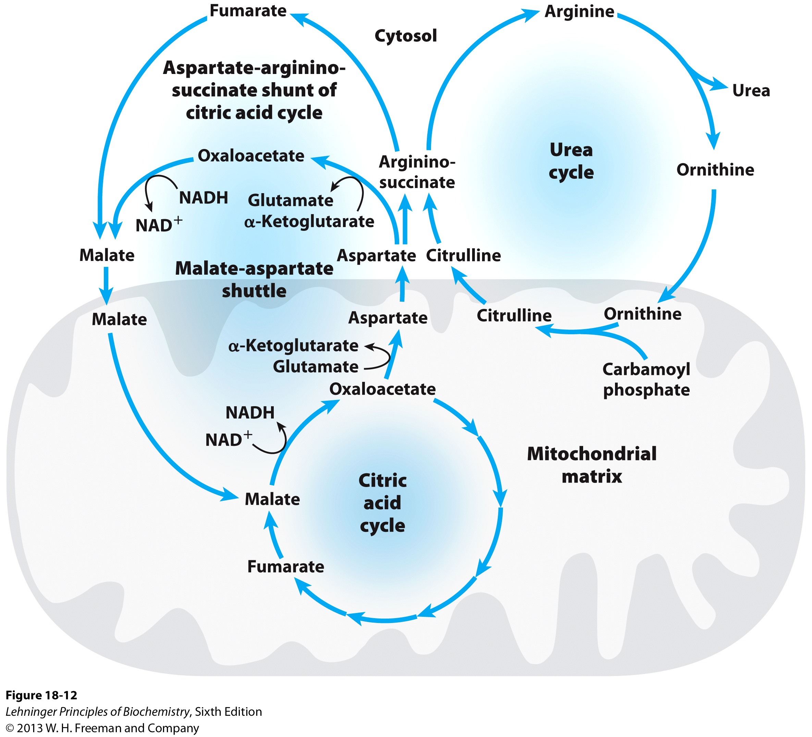
The aspartate-argininosuccinate shunt

Slide 39
The aspartate-argininosuccinate shunt
Citrin deficiency affects glycolysis and gluconeogenesis, besides the urea cycle

Slide 40
Overview of amino acid catabolism
Carboxyl group
Removal of the amino groups by transamination
The leftover carbon skeletons are converted to common intermediates of energy-producing pathways.
Amino group

Slide 41
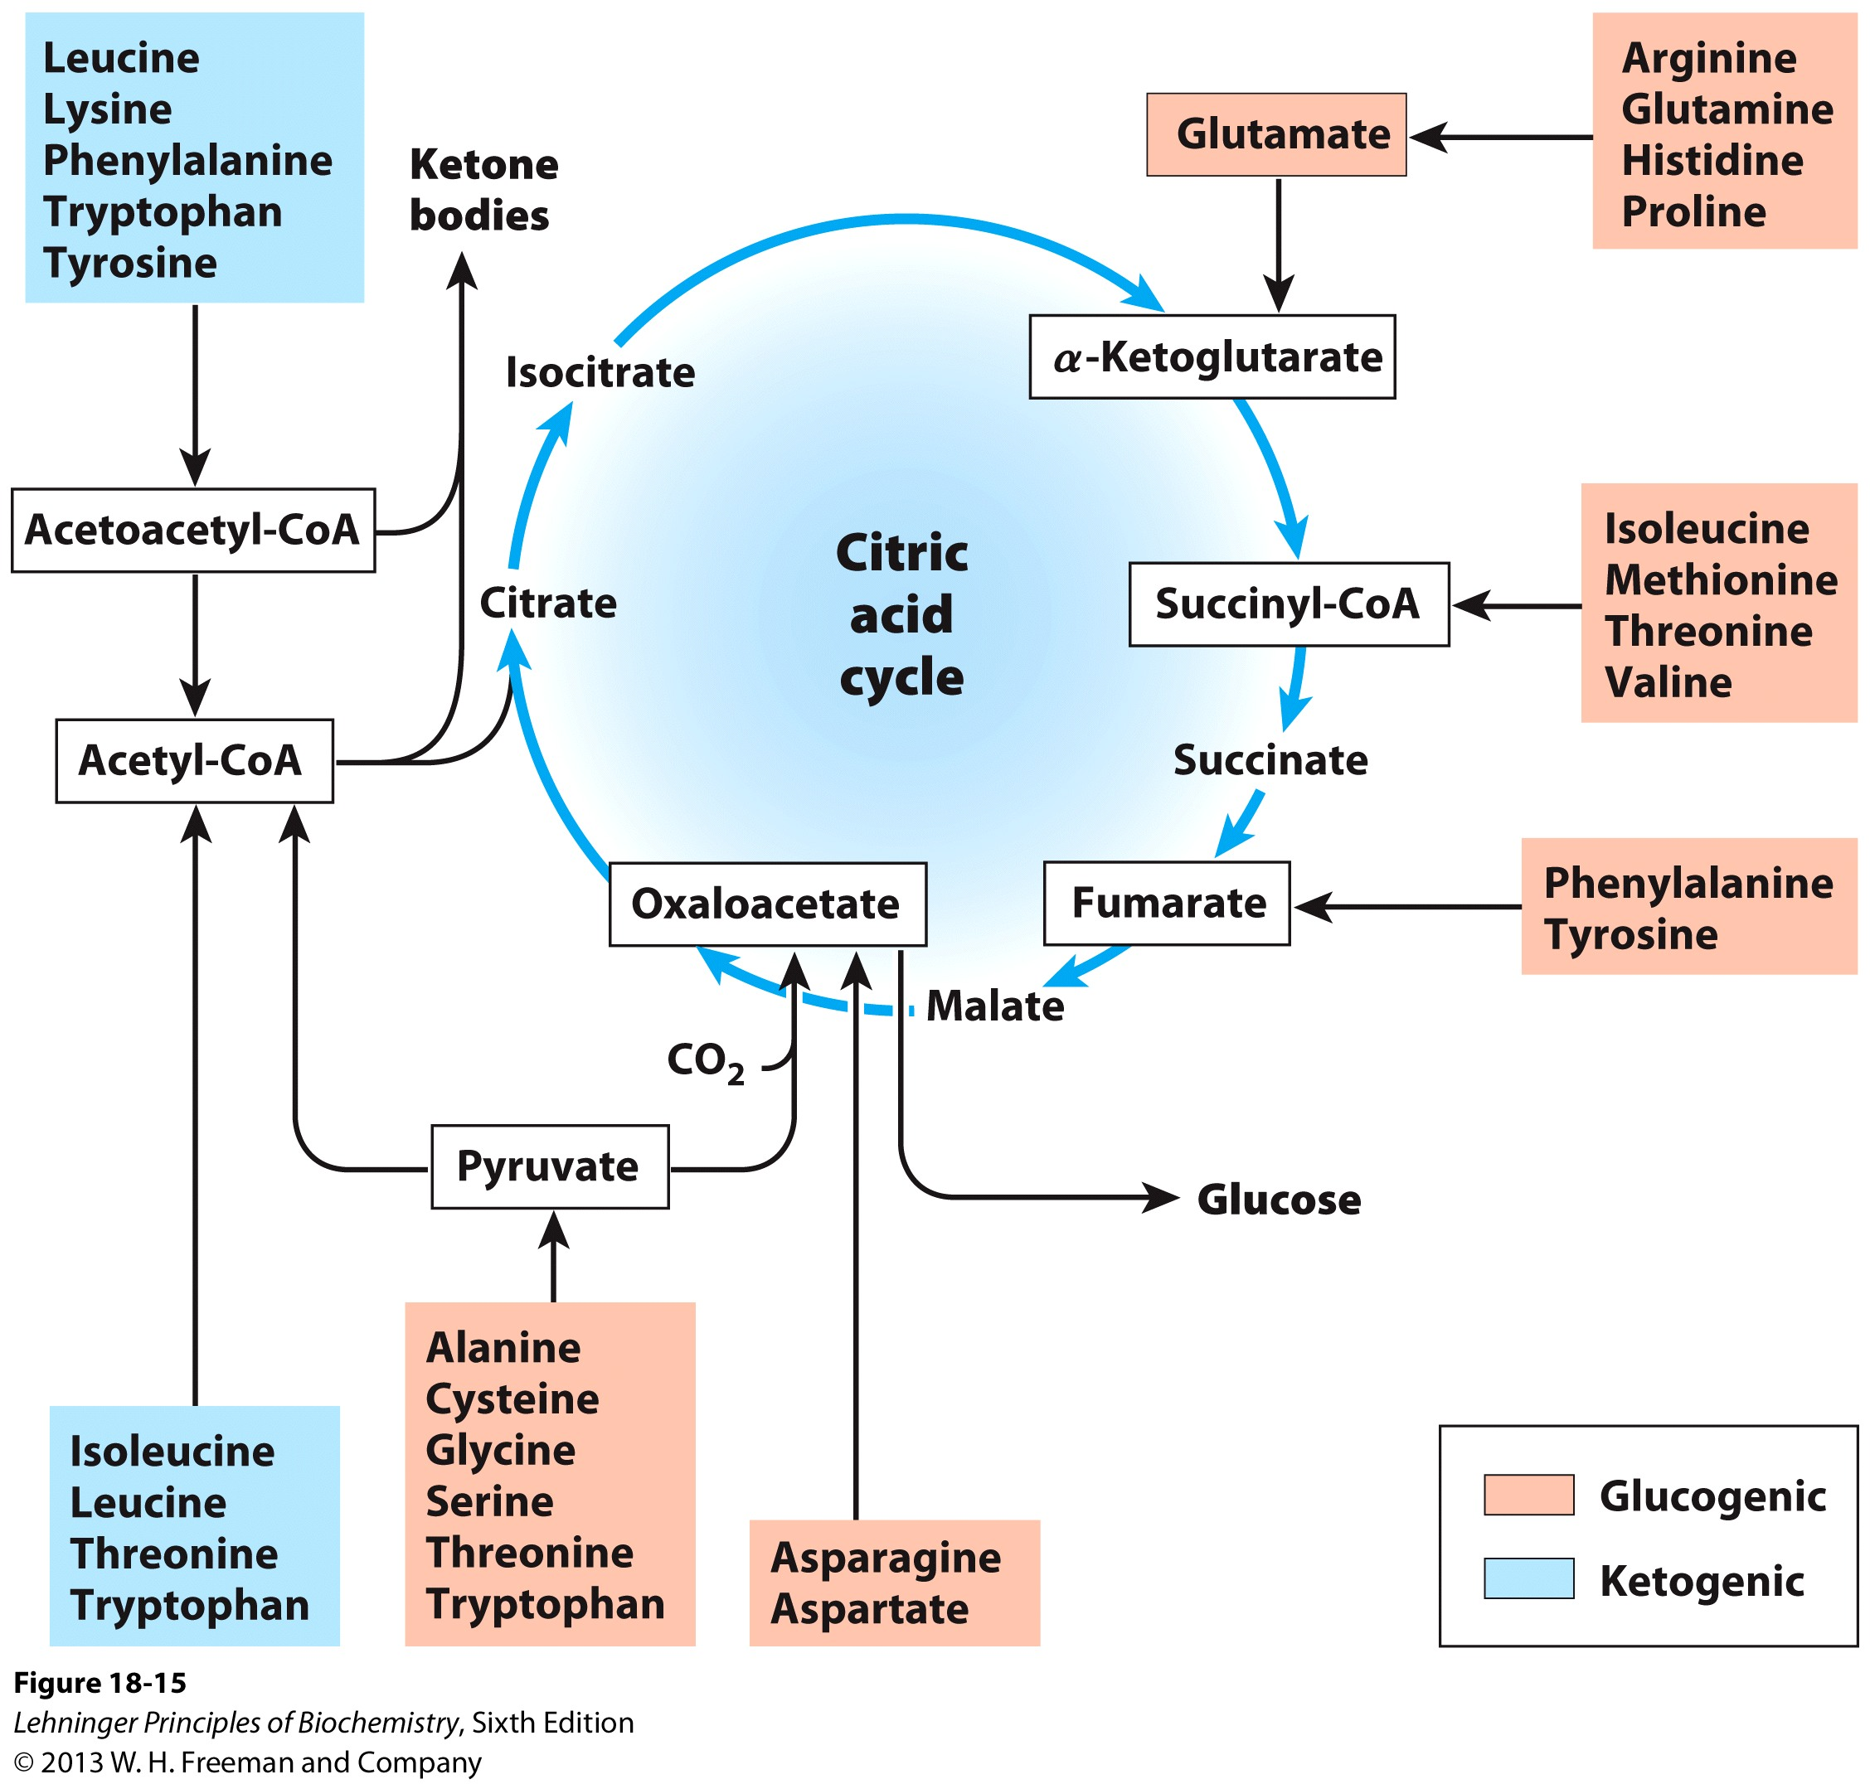
Amino acids metabolism are closely connected with TCA cycle and ketogenesis

Slide 42
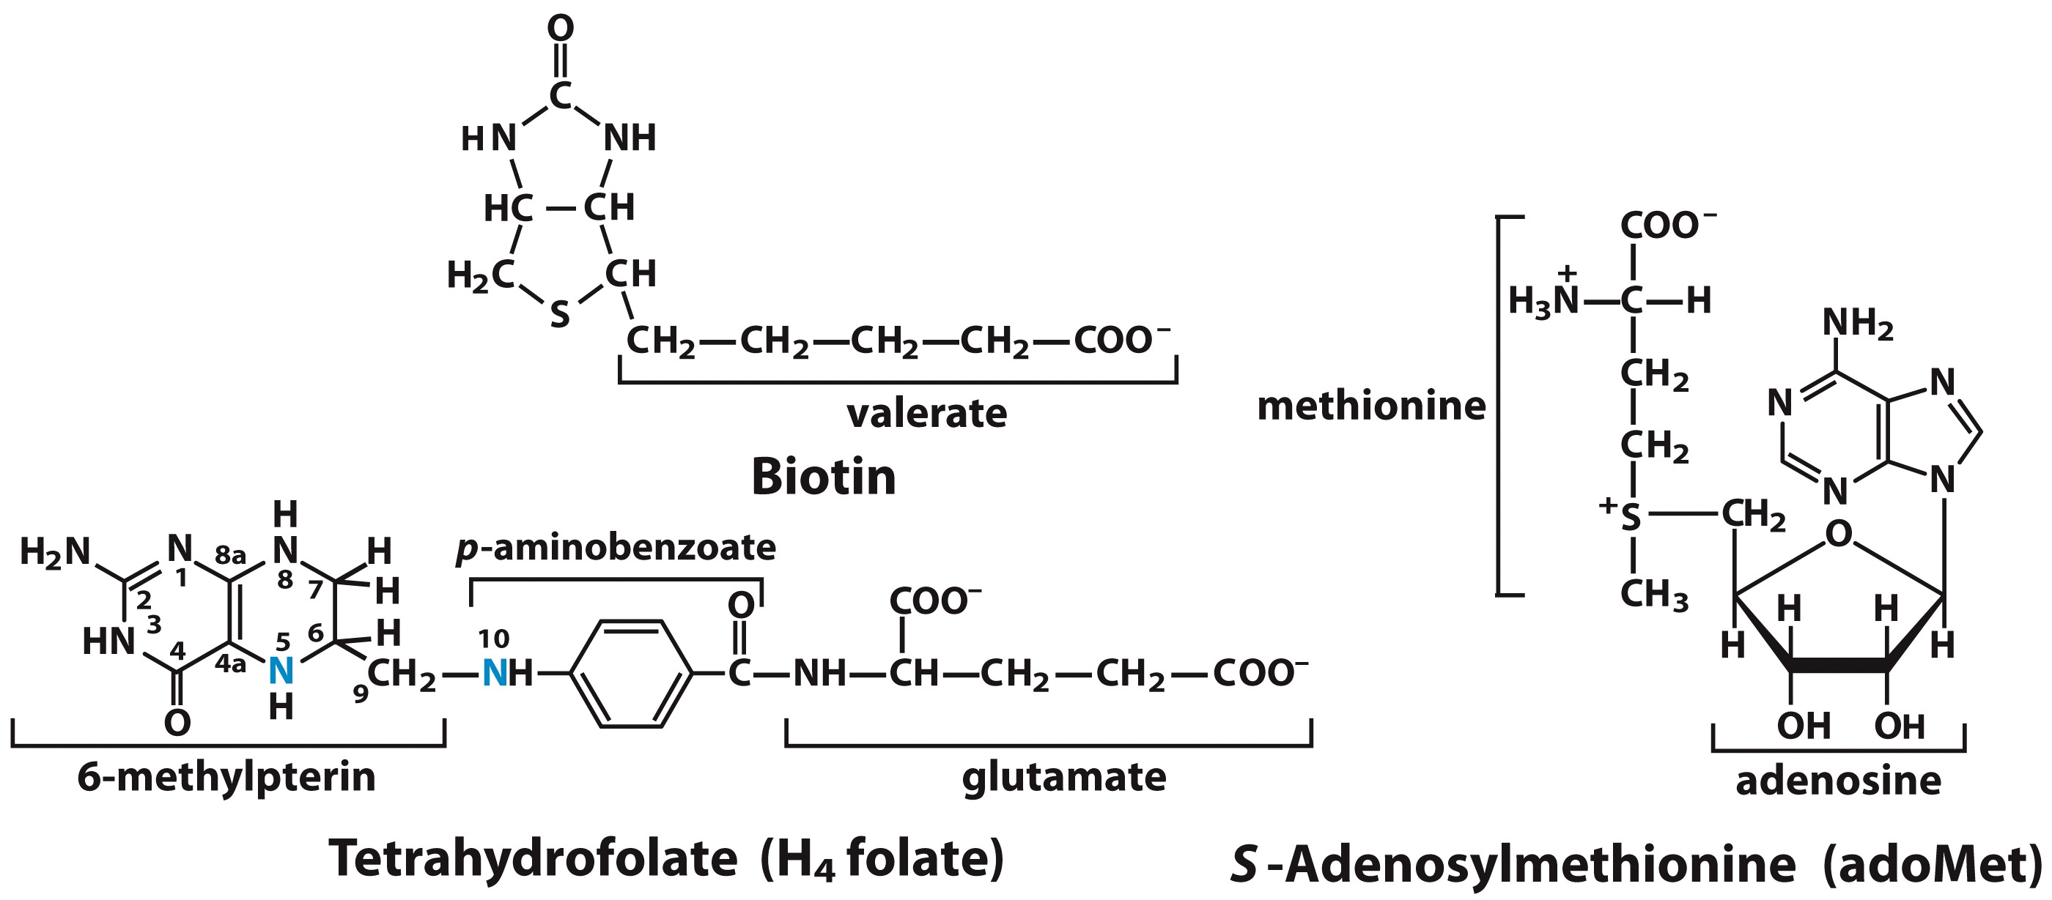
Cofactors important in one-carbon transfer reactions
Carrier of the most oxidized
one carbon unit
one carbon unit of
intermediate oxidation status
Carrier of the most
reduced one carbon unit

Slide 43
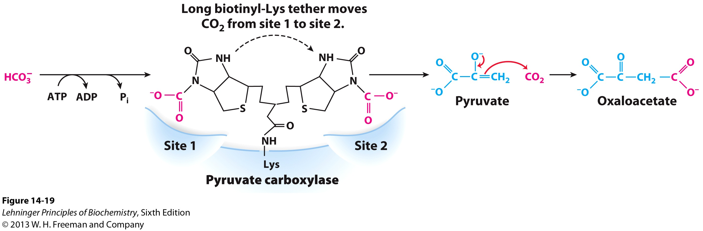
Biotin as coenzyme for carboxylases
The first step in gluconeogenesis

Slide 44
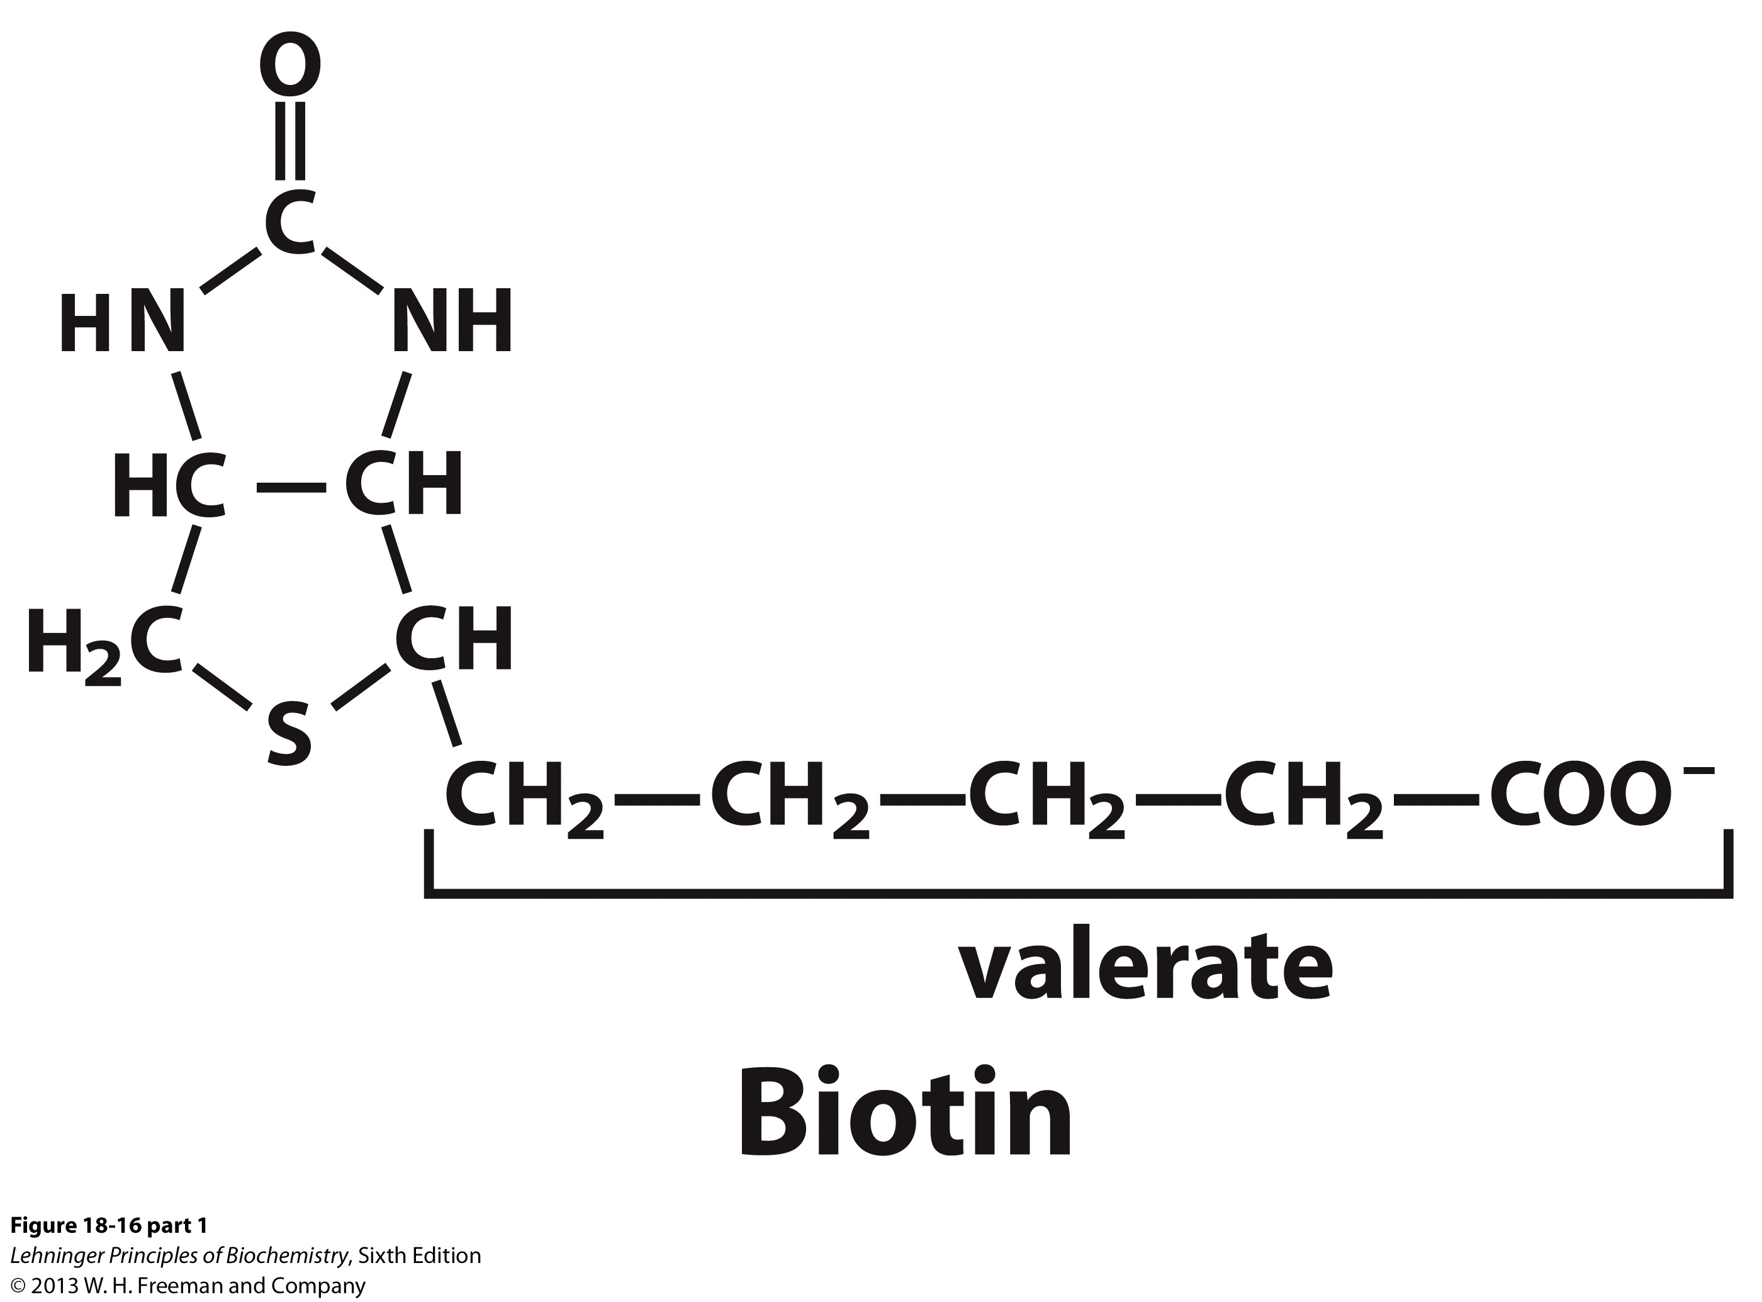
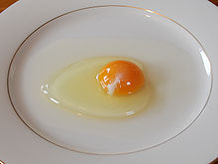
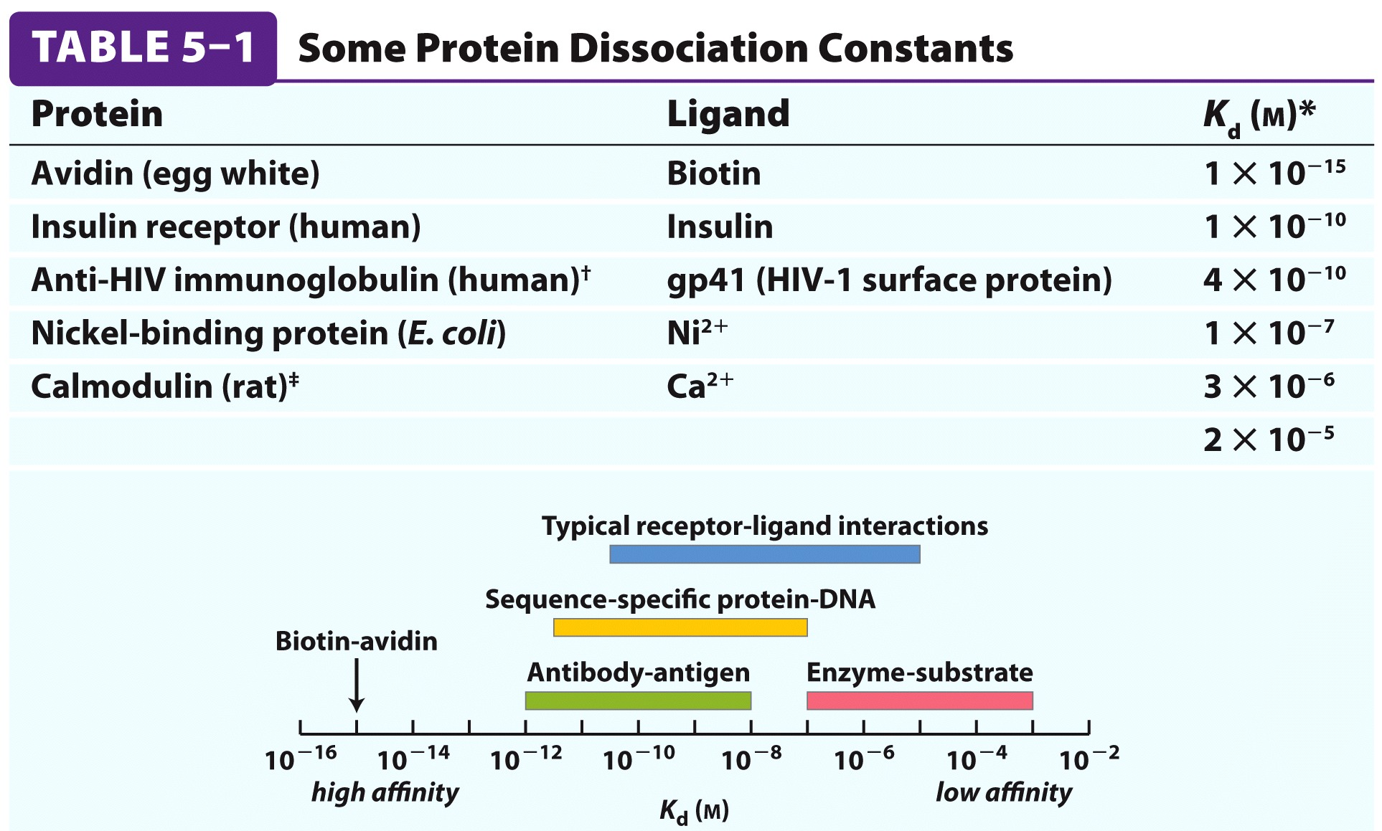
Notes:
Biotin: vitamin B7
Streptavidin

Slide 45
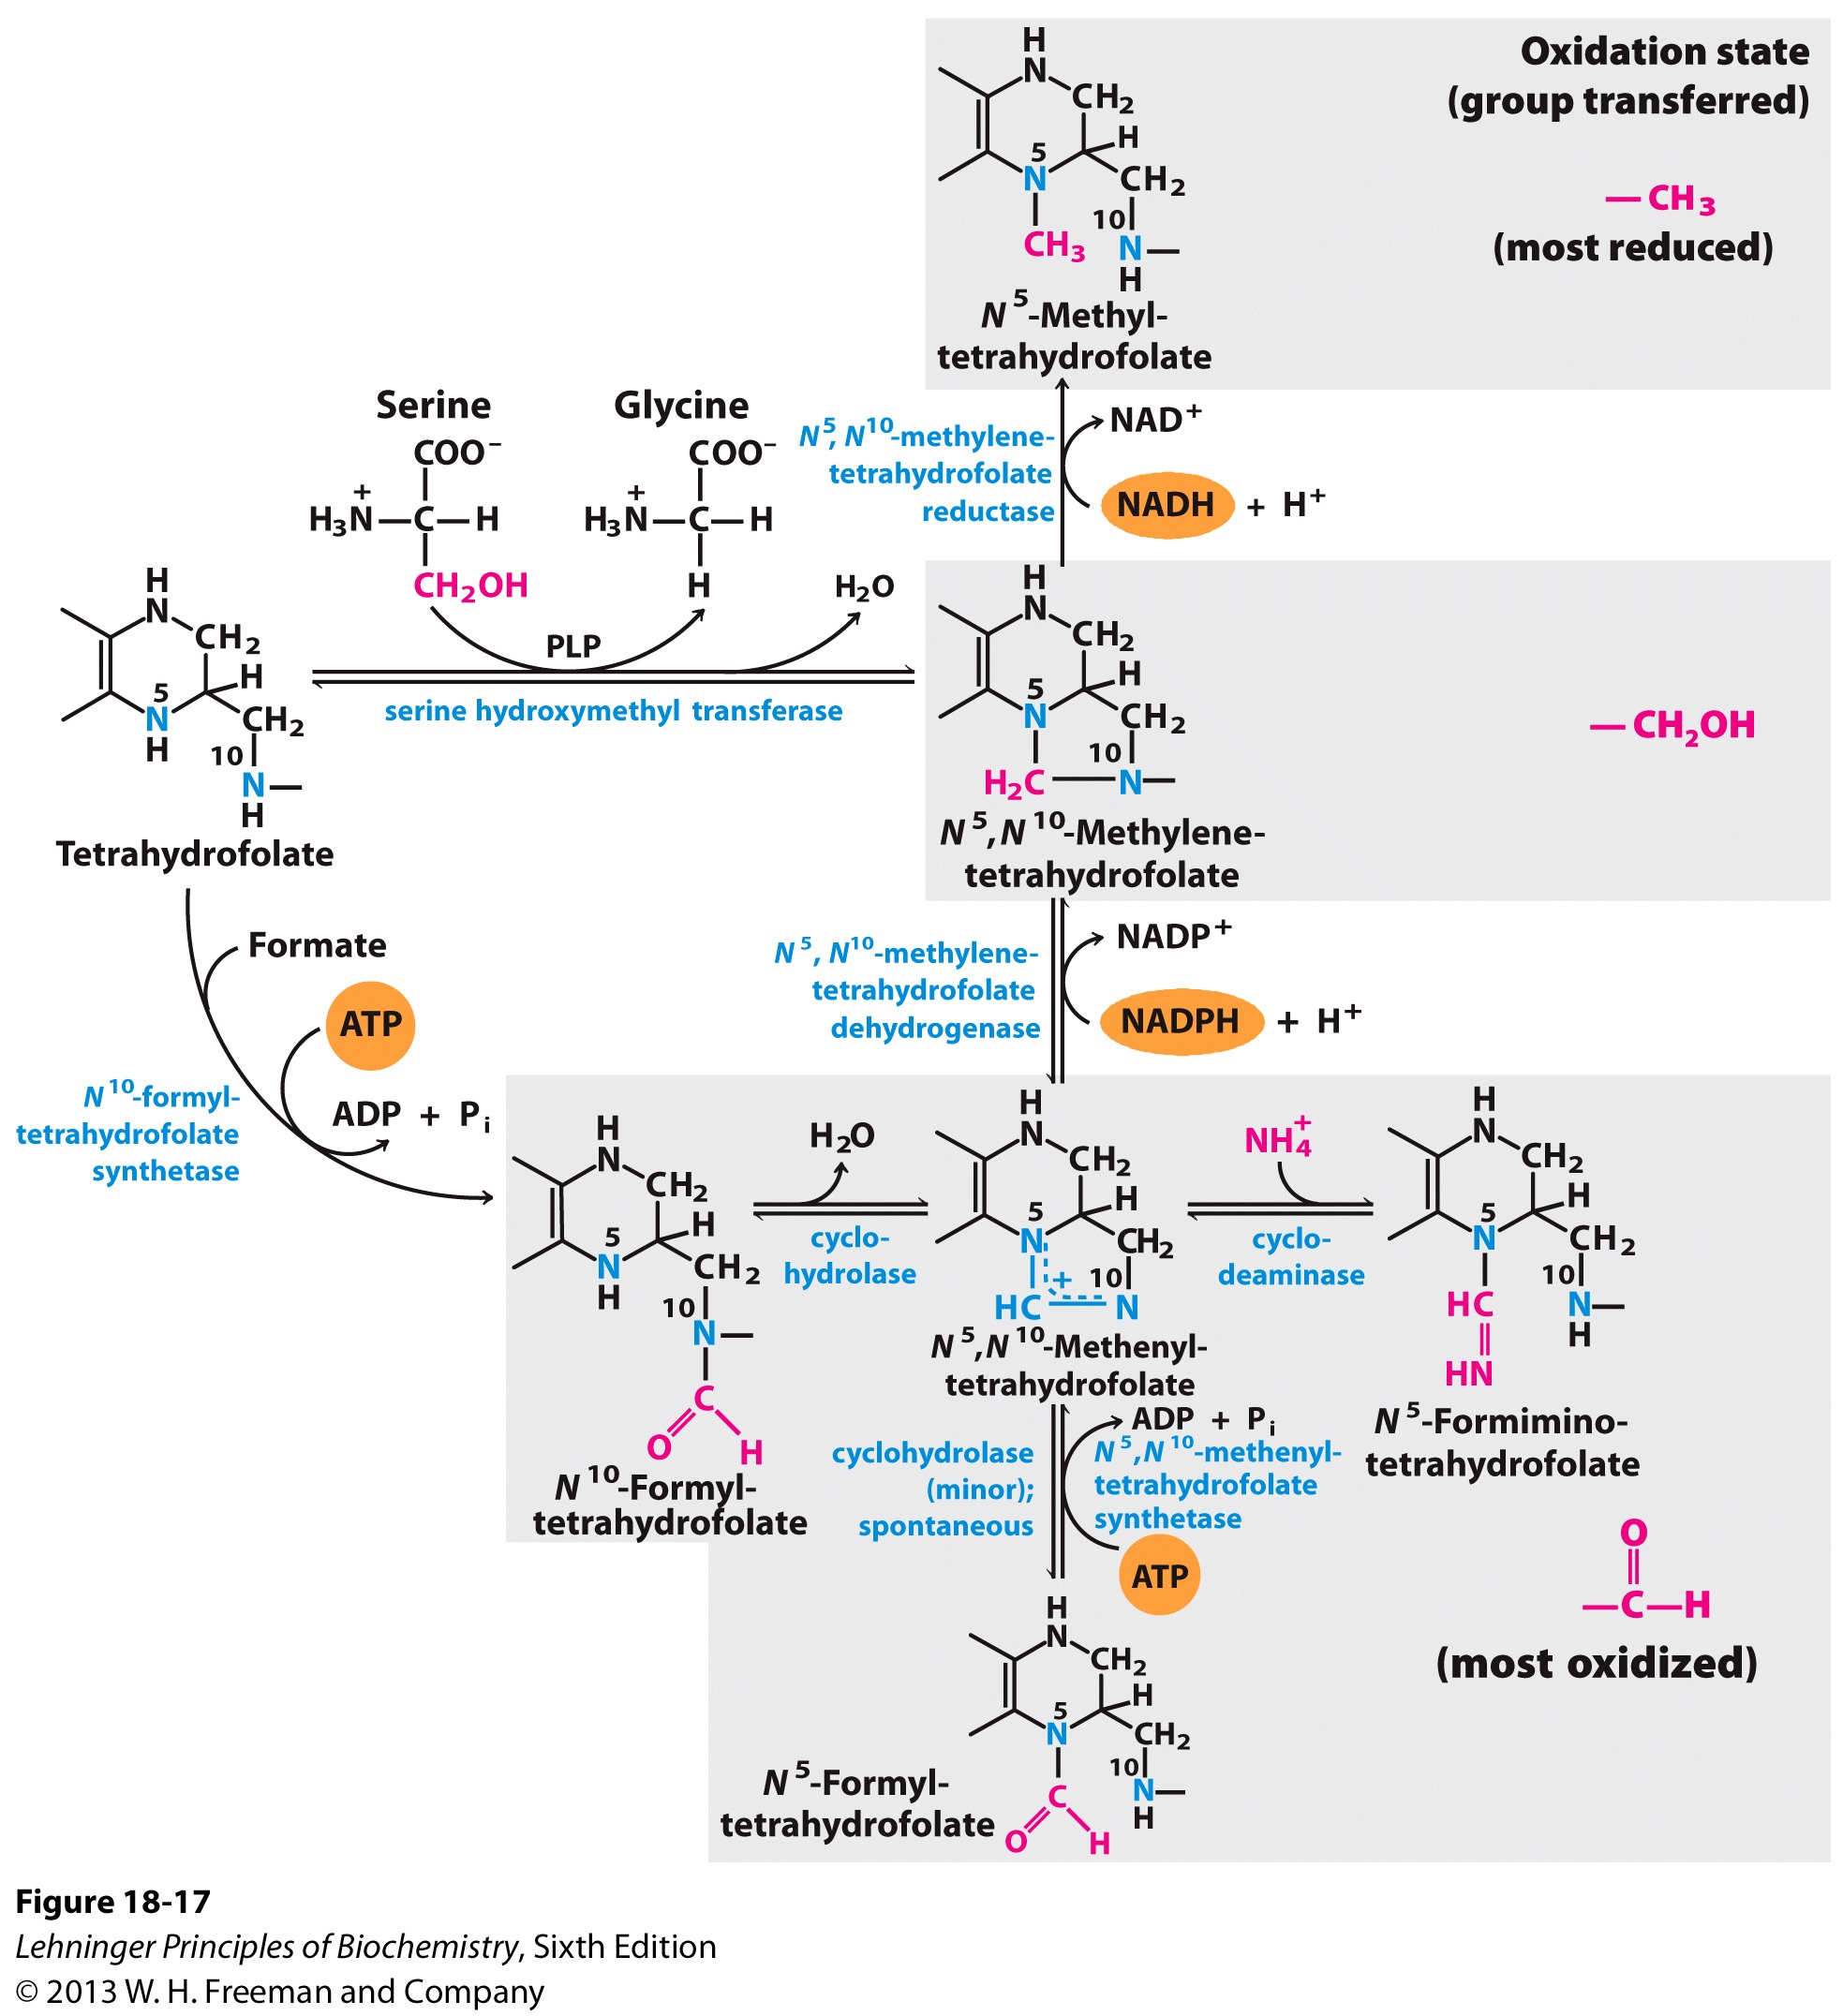
Tetrahydrofolate can transfer one-carbon units in 3 oxidation states
甲基
羟甲基
甲酰基

Slide 46
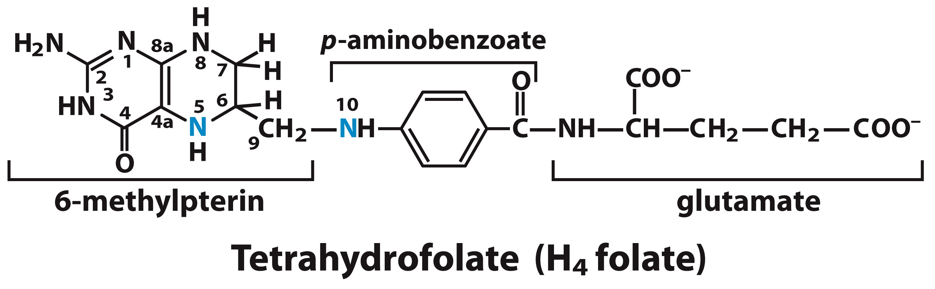
Tetrahydrofolate can transfer one-carbon units in a variety of oxidation states

Slide 47

Antibiotics targeting bacterial tetrahydrofolate synthesis
When used in combination, resulting in synergistic effects

Slide 48
Dihydrofolate (DHF) is from folic acid (vitamin B9) and is converted to tetrahydrofolate (THF) by dihydrofolate reductase (DHFR)
Dietary deficiency of folate, genetic deficiencies in folate metabolism, or increased catabolism of folate seen in some disease states, result in various metabolic effects leading to increased risk of developmental defects, cardiovascular disease, and cancer.

Slide 49

Methotrexate inhibits dihydrofolate reductase (DHFR) to inhibit the synthesis of DNA in chemotherapy
Dihydrofolate
Methotrexate

Slide 50

Synthesis of methionine and adoMet in an activated methyl cycle

Slide 51
Co-factor | One-carbon group transferred | Enzymes(e.g.)
Biotin | CO₂ (most oxidized) | Carboxylase
THF | CH₂, CH₂OH, CHO, etc (Intermediately oxidized), and CH₃ | A variety of enzymes
SAM | CH₃ (least oxidized) | Methyl transferase

Slide 52
Carbon skeletons of degraded amino acids emerge as major metabolic intermediates
The carbon skeletons of the amino acids are metabolized to seven major metabolic intermediates: pyruvate, α-ketoglutarate, succinyl-CoA, fumarate, oxaloacetate, acetyl-CoA, andacetoacetyl-CoA.
Amino acids metabolized to acetyl-CoA and acetoacetyl-CoA are called ketogenic amino acids because they can form fats but not glucose.
Amino acids degraded to the remaining major intermediates are called glucogenic amino acids because they can be used to synthesize glucose.
Only Leucine and Lysine are solely ketogenic.

Slide 54

Six amino acids are degraded to pyruvate

Slide 55

Serine is converted into pyruvate by the action of serine dehydratase

Slide 56
Glycine is degraded via 3 pathways, one of which leads to pyruvate

Slide 57
Glycine cleavage enzyme (glycine synthase) degrades glycine to CO₂ and NH₄⁺
Predominant pathway in mammals
Readily reversible
Also requires tetrahydrofolate
Defects cause nonketotic hyperglycinemia

Slide 58

Glycine can also be converted to glyoxylate
The primary function of D-amino acid oxidase, present at high levels in the kidney, is thought to detoxify ingested D-amino acids derived from food (grilled foodstuffs, for example)
Crystals of calcium oxalate account for up to 75% of all kidney stones

Slide 59
Calcium oxalate crystals in the urine

Slide 60
Catabolic pathways for Ala, Gly, Ser, Cys, Thr, and Trp
Alanine: to pyruvate directly by transamination;
Glycine: (1) to serine; (2) to CO₂ + NH₄⁺; (3) to glyoxylate and oxylate
Serine: to pyruvate by serine dehydratase (remove amino group and hydroxy group in a single PLP-dependent reaction), or to glycine
Threonine: generate acetyl-CoA + glycine (10-30% of threonine catabolism, major pathway in humans lead to succinyl-CoA)
Cysteine: via two steps to pyruvate (remove sulfur atom and transamination)
Tryptophan: generate alanine, and acetyl-CoA

Slide 62

Seven amino acids are degraded to Acetyl-CoA

Slide 63

Catabolism of phenylalanine and tyrosine

Slide 64

Phenylalanine hydroxylase (PAH) reaction
Phenylalanine hydroxylase catalyzes simultaneous hydroxylation of a substrate by an oxygen atom of O₂ and reduction of the other oxygen atom to H₂O (monooxygenases, mixed-function oxidases).
Requires the cofactor tetrahydrobiopterin.

Slide 65



(苯丙酮尿症)
One of the first inheritable, and also one of the most common metabolic defects discovered in humans. A deficit in tetrahydrobiopterin biosynthesis and/or regeneration can also result in phenylketonuria (PKU) .

Slide 66

Alternative catabolic pathway for phenylalanine with defective PAH reaction

Slide 67
Genetic defects in many phenylalanine catabolic enzymes cause diseases
黑尿酸症
酪氨酸血症

Slide 68


Alcaptonuria
Alcaptonuria is a disease that results from the absence of homogentisate dioxidase (HGD).
Early in the twentieth century, Archibald Garrod, a physician, made several observations about alkaptonuria and proceeded to proposed that the information for producing specific enzymes in humans is inherited. He observed that inherited diseases reflect a patient's inability to make a particular enzyme, which he referred to as "inborn errors of metabolism“.
Homogentisate accumulates and upon excretion, turns the urine dark.

Slide 69
Catabolism of Phe and Tyr also generates fumarate

Slide 70
Both glucogenic and ketogenic

Slide 71

Intermediates of tryptophan catabolism are used as precursors for the synthesis of other biomolecules
5-羟色胺

Slide 73

Pro, Glu, Gln, Arg, and His are converted to a-KG
Notes:
Glutamate
Glutamine
His and N5 formimino H4 folate

Slide 75

Asparagine and Aspartate are converted to oxaloacetate

Slide 77

Met, Ile, Thr and Val are converted into propionyl CoA

Slide 78


Complete oxidation of odd number fatty acids require 3 additional steps

Slide 79

Methylmalonlyl-CoA mutase deficiency leads to Methylmalonic acidemia (MMA, 甲基丙二酸血症)
1 in 48,000 newborns and presents symptoms almost identical with those caused by ethylene glycol poisoning.

Slide 80
Ethylene glycol is used in antifreeze applications
Ethylene glycol is moderately toxic, with children having been particularly at risk because of its sweet taste.
Australia, the U.K., and seventeen U.S. states (as of 2012) require the addition of a bitter flavoring (denatonium benzoate) to antifreeze; in 2012, U.S. antifreeze manufacturers agreed voluntarily to add a bitter flavoring to all antifreeze that is sold in the consumer market of the U.S.

Slide 83


Branched-chain a-keto acid is catabolized by oxidative decarboxylation in extrahepatic tissues
Branched chain amino acids are oxidized in muscle, adipose tissue, and kidney.
Notes:
Not in liver

Slide 84

α-ketoglutarate dehydrogenase is similar to the pyruvate dehydrogenase and branched chain a-keto acid dehydrogenase complexes

Slide 85
Defects in branched-chain a-keto acid dehydrogenase complex cause the maple syrup urine disease
The disease is named for the presence of sweet-smelling urine, with an odor similar to that of maple syrup.
Notes:
Not in liver

Slide 86



Slide 87
Key aspects of amino acid catabolism
Glucogenic: catabolism of glycine, glutamine/glutamate, asparagine/aspartate
Glucogenic and ketogenic: phenylalanine and tyrosine
One carbon transfer reactions, methionine metabolism (SAM cycle)
Branched chain amino acids

